Slide 1
Data Link Layer
Chapter-3

Slide 2
Data Link Layer
The data link layer is the second layer from the bottom in the OSI (Open System Interconnection) network architecture model.
Responsible for the node-to-node delivery of data within the same local network.
Major role is to ensure error-free transmission of information.
Also responsible for encoding, decoding, and organizing the outgoing and incoming data.
Considered as the most complex layer of the OSI model as it hides all the underlying complexities of the hardware from the other above layers.

Slide 3
Functions of Data Link layer
• Framing: The Data Link Layer breaks down data into smaller frames for transmission across the physical network. Each frame contains a header with important information like source and destination MAC addresses.
• Error Detection and Correction: It checks for errors that may occur during transmission and can request retransmission of data if necessary. Error detection is commonly done using techniques like CRC (Cyclic Redundancy Check).
• Flow Control: It manages the pace at which data is sent, ensuring that the sender doesn't overwhelm the receiver by sending data too quickly.
• Addressing: The Data Link Layer uses physical addresses (MAC addresses) to identify devices on the local network, allowing data to be sent to the correct destination device within the network.
• Access Control: It determines when a device can transmit data over a shared medium, using protocols like Ethernet, which employ Carrier Sense Multiple Access with Collision Detection (CSMA/CD) to avoid collisions on the network.

Slide 4
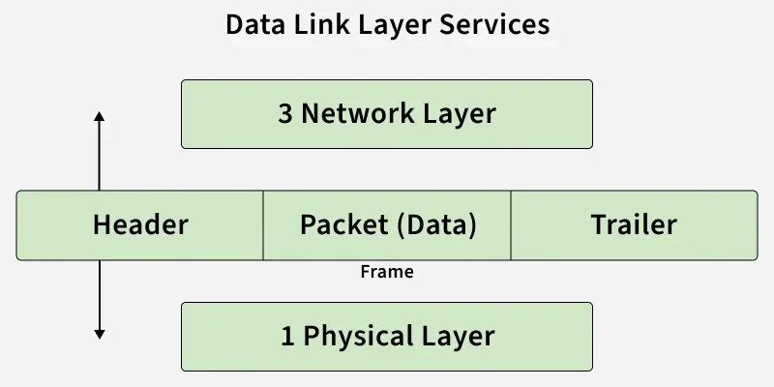
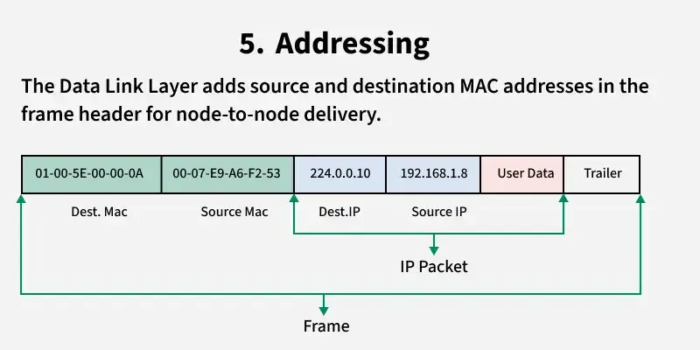
Framing in DLL
A frame at the Data Link Layer contains several key components to ensure proper communication between devices on a local network. The typical structure of a frame includes:
Header: This contains control information for the frame, such as:
Source MAC Address: The unique hardware address of the device sending the data.
Destination MAC Address: The unique hardware address of the device receiving the data.
Frame Type: Specifies the protocol or type of data being transmitted, e.g., IPv4, IPv6, ARP.
Control Information: This can include flags or additional control data like flow control or sequence numbers.
Payload/Data: This is the actual data being transmitted. It can contain:
The encapsulated higher-layer data: This could be a packet from the Network Layer (such as an IP packet) or other types of data.
The payload is typically the largest part of the frame.
Trailer: This usually contains error-checking data:
Frame Check Sequence (FCS): A value used for error detection, often using a technique like CRC (Cyclic Redundancy Check). It ensures that the data has not been corrupted during transmission.

Slide 5
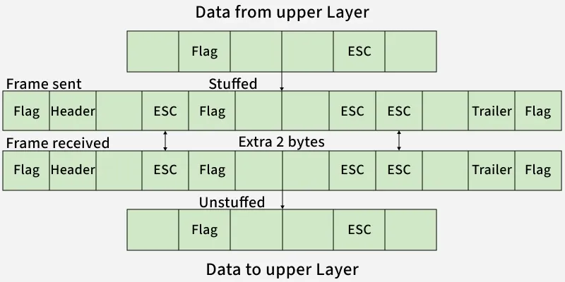
Types of Framing
1. Fixed-Size Framing
Frames have a predefined, fixed size.
No explicit start or end delimiters are needed; the frame size itself acts as the boundary.
Drawback: Internal fragmentation occurs when the data is smaller than the frame size, wasting bandwidth.
Solution: Padding is used to fill the frame to its full size.

Slide 6
2. Variable-Size Framing
This method requires explicit indicators of frame boundaries and includes two popular techniques:
Length Field: The frame includes a length field that specifies the frame size. Used in Ethernet (802.3). Here, If the length field gets corrupted, the frame cannot be parsed correctly.
End Delimiter (ED): A unique pattern marks the end of the frame. Used in Token Ring networks. Here, The ED pattern may occur in the data.
To solve this problem, two stuffing techniques are used:
(a) Character/Byte Stuffing
Used when data is character-based.
If the data contains the special delimiter character (e.g., $), an escape character (e.g., \O) is inserted to distinguish it.
Example: If ED = $, and data contains $, it becomes \O$. Disadvantage: High processing overhead and obsolete in modern systems.
(b) Bit Stuffing

Slide 7
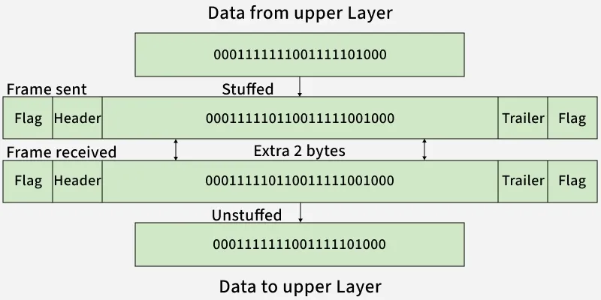

Slide 8
Problems in Framing
Framing in computer networks faces several challenges:
Start and End Detection :The receiver must correctly identify frame boundaries using delimiters or flags.
Synchronization: Sender and receiver must stay aligned on frame timing, especially in high-speed networks.
Error Handling: Noise can corrupt data or delimiters; error detection methods like CRC or checksums are used.
Overhead: Headers and trailers add control information but reduce usable bandwidth.
Efficiency: The goal is to maximize payload while minimizing overhead and processing delays.
Compatibility: Different devices may use different framing methods, causing misinterpretation.

Slide 9
Flow Control
Flow control in the data link layer is primarily responsible for managing the rate of data transmission between two devices to prevent overwhelming the receiver.
This is critical because the receiver might not be able to handle data as quickly as the sender transmits, leading to loss of data or congestion.
Flow control mechanisms ensure that data is transmitted at a rate that the receiver can process.
There are two main types of flow control in the data link layer:
i. Stop and Wait flow control
Ii. Sliding window

Slide 10
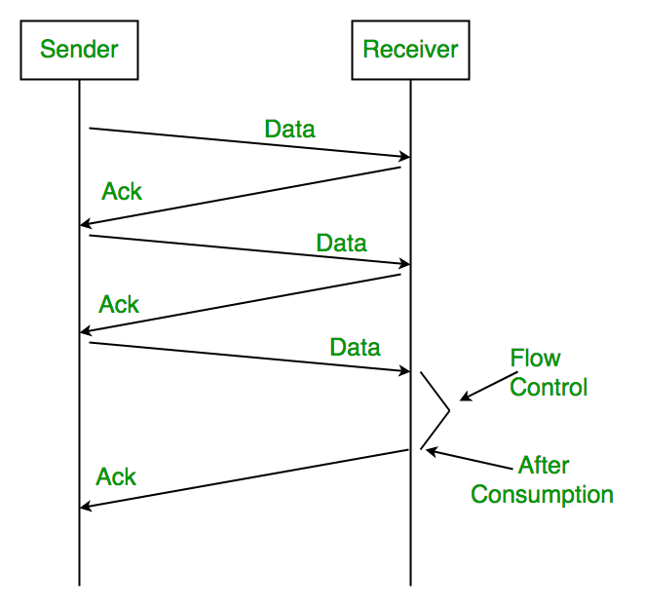
Stop and wait flow control
How Stop-and-Wait Flow Control Works:
Frame Transmission: The sender sends a single data frame to the receiver.
Wait for Acknowledgment: After sending the frame, the sender stops and waits for an acknowledgment (ACK) from the receiver indicating that the frame was successfully received.
Frame Acknowledgment: Once the receiver successfully receives the frame, it sends an acknowledgment back to the sender. This ACK confirms the successful receipt of the frame.
Send Next Frame: After receiving the acknowledgment, the sender sends the next frame in the sequence.
Timeout: If the sender does not receive an acknowledgment within a specific time frame (due to network issues, packet loss, etc.), it will retransmit the frame. This is known as a timeout mechanism.

Slide 11
Sliding Windows
Key Elements of Sliding Window:
Sender Window: The sender can send multiple frames within a certain window size, without needing to wait for an acknowledgment after each frame. The window size is determined by the receiver's buffer space or the maximum number of frames it can handle at once.
Receiver Window: The receiver also has a window that specifies how many frames it can receive without sending an acknowledgment. Once it processes the frames in the window, the window "slides" to make space for more incoming frames.
Window Size: The window size can be adjusted based on the receiver’s capacity and current network conditions. It defines how many frames the sender can transmit without waiting for individual acknowledgments for each frame.
Acknowledgment (ACK): The receiver sends back an acknowledgment for one or more frames, indicating that those frames have been successfully received and processed. This acknowledgment also informs the sender of which frames can be safely transmitted next.

Slide 12
Mechanism:
Sender Side:
The sender maintains a window of frames it is allowed to send.
It sends a number of frames equal to the window size.
The sender does not wait for an acknowledgment after sending each frame but continues sending frames as long as the window allows.
When the receiver sends an acknowledgment, the sender slides its window forward, allowing the transmission of new frames.
Receiver Side:
The receiver maintains a window that tells the sender how many frames it can handle.
After receiving a frame, the receiver sends an acknowledgment, indicating which frame it is acknowledging, and slides its window to accept the next frame.
Types of Sliding Window Protocols:
Go-Back-N (GBN) Protocol:
In Go-Back-N, the sender can send multiple frames within the window, but if any frame is lost or corrupted, the receiver will discard it, and the sender must retransmit the lost frame and all subsequent frames.
Acknowledgment is cumulative, meaning that a single acknowledgment can confirm the receipt of multiple frames.
Selective Repeat (SR) Protocol:
In Selective Repeat, the sender can also send multiple frames, but if a frame is lost or corrupted, only that frame needs to be retransmitted.
Each frame is individually acknowledged, and the sender does not need to retransmit correctly received frames.

Slide 13
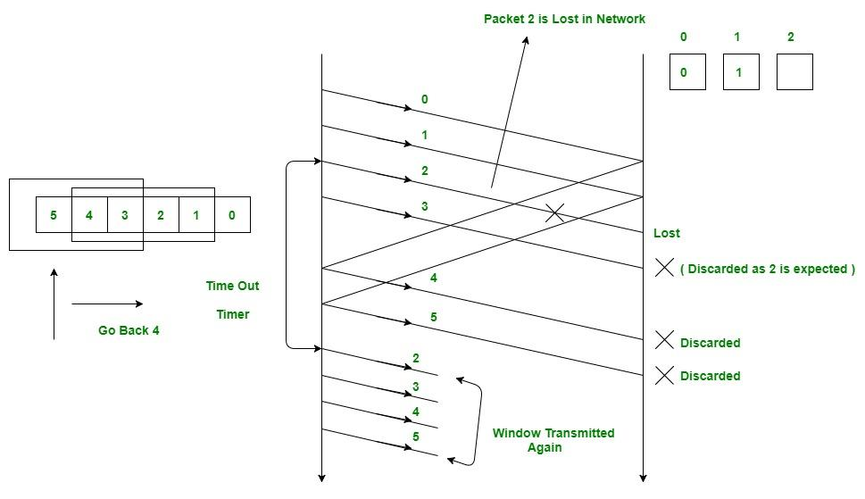

Slide 14
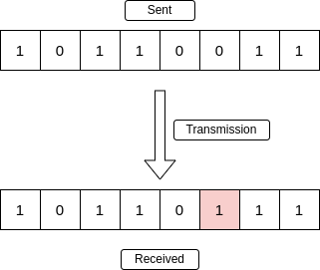
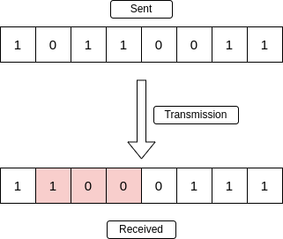
Error Detection and Correction
Error Detection
Error detection in computer networks ensures that data is transmitted accurately without corruption. It works by adding extra (redundant) bits to data so the receiver can verify its correctness. If errors are found, the receiver discards the frame and requests retransmission.
Detects errors caused by noise or interference.
Uses redundant bits for consistency checking.
Common methods: Parity Check, Checksum, CRC.
Ensures data integrity and reliable communication.
Types of Errors
1. Single-Bit Error
A single-bit error refers to a type of data transmission error that occurs when one bit (i.e., a single binary digit) of a transmitted data unit is altered during transmission, resulting in an incorrect or corrupted data unit.
2. Burst Error
The term burst error means that 2 or more bits in the data unit have changed from 1 to 0 or from 0 to 1

Slide 15
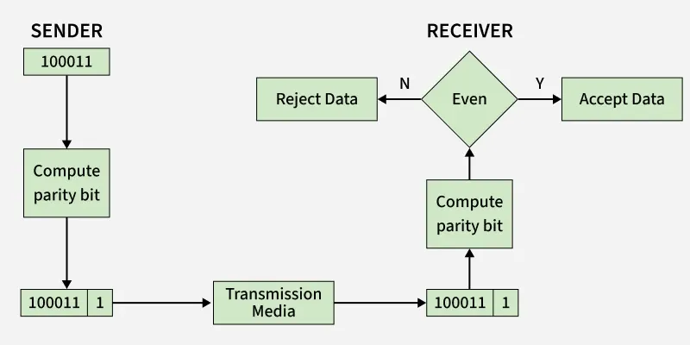
Error Detection
1. Simple Parity Check
Simple bit parity is a simple error detection method that involves adding an extra bit to a data transmission. It works as:
Parity bits are used for error detection in data transmission. There are two types:
Even Parity
➤ The number of 1’s in each code word including the parity bit must be even.
Odd Parity
➤ The number of 1’s in each code word including the parity bit must be odd.

Slide 16
Advantages and Disadvantages
Disadvantages of Simple Parity Check
Single Parity check is not able to detect even no. of bit error.
For example: the Data to be transmitted is 101010. Codeword transmitted to the receiver is 1010101 (we have used even parity). Let's assume that during transmission, two of the bits of code word flipped to 1111101. On receiving the code word, the receiver finds the no. of ones to be even and hence no error, which is a wrong assumption.
Advantages of Simple Parity Check
Simple parity check can detect all single bit error.
Simple parity check can detect an odd number of errors.
Implementation: Simple Parity Check is easy to implement in both hardware and software.
Minimal Extra Data: Only one additional bit (the parity bit) is added per data unit (e.g., per byte).
Fast Error Detection: The process of calculating and checking the parity bit is quick, which allows for rapid error detection without significant delay in data processing or communication.
Single-Bit Error Detection: It can effectively detect single-bit errors within a data unit, providing a basic level of error detection for relatively low-error environments.

Slide 17
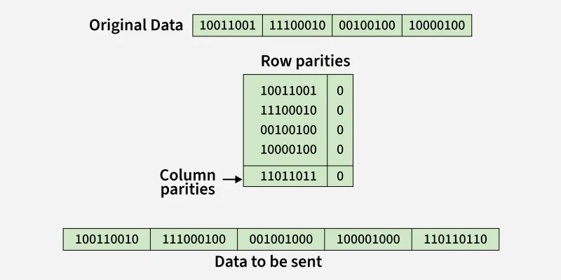
2. Two-Dimensional Parity Check
Two-dimensional Parity check bits are calculated for each row, which is equivalent to a simple parity check bit. Parity check bits are also calculated for all columns, then both are sent along with the data. At the receiving end, these are compared with the parity bits calculated on the received data.
2-D Parity Check
Advantages of Two-Dimensional Parity Check
Two-Dimensional Parity Check can detect and correct all single bit error.
Two-Dimensional Parity Check can detect two or three bit error that occur any where in the matrix.
Disadvantages of Two-Dimensional Parity Check
Two-Dimensional Parity Check can not correct two or three bit error. It can only detect two or three bit error.
If we have a error in the parity bit then this scheme will not work.

Slide 18
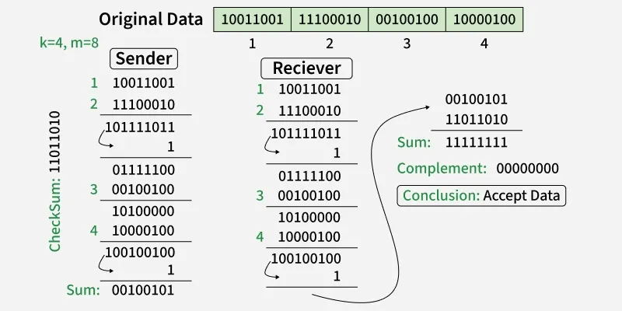
3. Checksum
Checksum error detection is a method used to identify errors in transmitted data. The process involves dividing the data into equally sized segments and using a 1's complement to calculate the sum of these segments. The calculated sum is then sent along with the data to the receiver. At the receiver's end, the same process is repeated and if all zeroes are obtained in the sum, it means that the data is correct.
Checksum - Operation at Sender's Side
Firstly, the data is divided into k segments each of m bits.
On the sender’s end, the segments are added using 1’s complement arithmetic to get the sum. The sum is complemented to get the checksum.
The checksum segment is sent along with the data segments.
Checksum - Operation at Receiver's Side
At the receiver’s end, all received segments are added using 1’s complement arithmetic to get the sum. The sum is complemented.
If the result is zero, the received data is accepted; otherwise discarded.

Slide 19
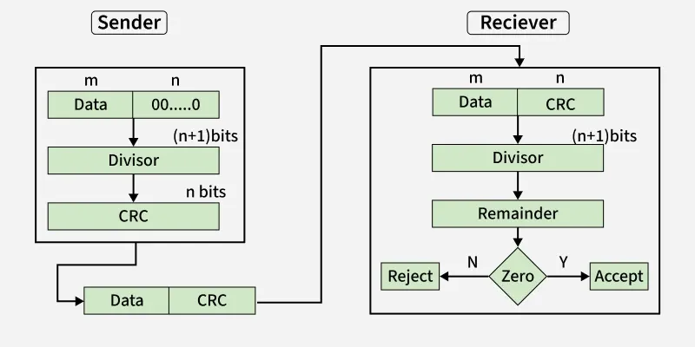
4. Cyclic Redundancy Check (CRC)
Unlike the checksum scheme, which is based on addition, CRC is based on binary division.
In CRC, a sequence of redundant bits, called cyclic redundancy check bits, are appended to the end of the data unit so that the resulting data unit becomes exactly divisible by a second, predetermined binary number.
At the destination, the incoming data unit is divided by the same number. If at this step there is no remainder, the data unit is assumed to be correct and is therefore accepted.
A remainder indicates that the data unit has been damaged in transit and therefore must be rejected.
CRCCRC Working
We have given dataword of length n and divisor of length k.
Step 1: Append (k-1) zero's to the original message Step 2: Perform modulo 2 division Step 3: Remainder of division = CRC Step 4: Code word = Data with append k-1 zero's + CRC
Note:
CRC must be k-1 bits
Length of Code word = n+k-1 bits
Example: Let's data to be send is 1010000 and divisor in the form of polynomial is x3+1. CRC method discussed below.

Slide 20
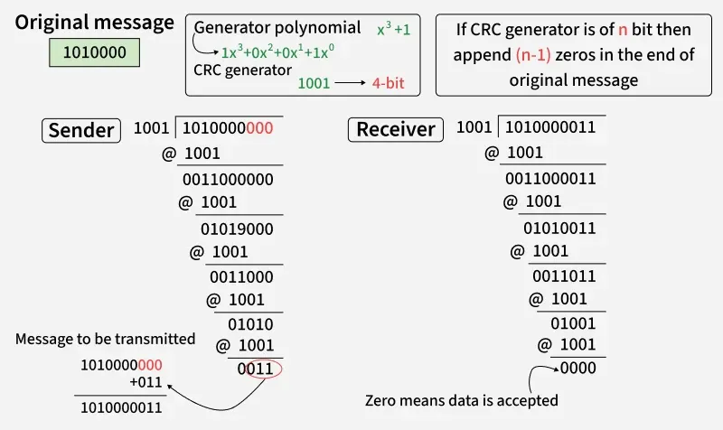

Slide 21
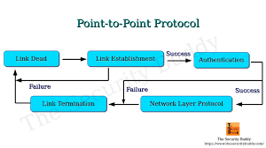
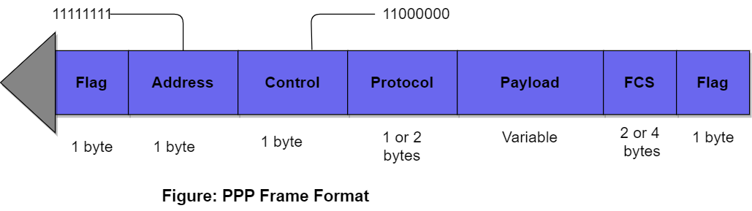
Point to Point Protocol
Point-to-Point Protocol (PPP) is a data link layer protocol commonly used for establishing a direct connection between two nodes over serial links, such as dial-up or leased lines. It provides a standard method for transmitting multi-protocol datagrams over point-to-point links.
Key Components of PPP:
LCP (Link Control Protocol): Manages the link setup, configuration, and termination.
NCP (Network Control Protocol): Handles the setup and configuration of network layer protocols (e.g., IP, IPX).
Authentication: PAP or CHAP for verifying identities.
Error Detection: FCS for detecting errors during transmission.

Slide 22
How PPP works
1. PPP Frame format:
PPP uses frames to encapsulate network layer packets (such as IP packets) for transmission. The PPP frame structure consists of five key parts:
Flag field - PPP frame similar to HDLC frame, always begins and ends with standard HDLC flag. It always has a value of 1 byte i.e., 01111110 binary value.
Address field - Address field is basically broadcast address. In this, all 1’s simply indicates that all of the stations are ready to accept frame. It has the value of 1 byte i.e., 11111111 binary value. PPP on the other hand, does not provide or assign individual station addresses.
Control field - This field basically uses format of U-frame i.e., Unnumbered frame in HDLC. In HDLC, control field is required for various purposes but in PPP, this field is set to 1 byte i.e., 00000011 binary value. This 1 byte is used for a connection-less data link.
Protocol field - This field basically identifies network protocol of the datagram. It usually identifies the kind of packet in the data field i.e., what exactly is being carried in data field. This field is of 1 or 2 bytes and helps in identifies the PDU (Protocol Data Unit) that is being encapsulated by PPP frame.
Data field - It usually contains the upper layer datagram. Network layer datagram is particularly encapsulated in this field for regular PPP data frames. Length of this field is not constant rather it varies.
FCS field - This field usually contains checksum simply for identification of errors. It can be either 16 bits or 32 bits in size. It is also calculated over address, control, protocol, and even information fields. Characters are added to frame for control and handling of errors.

Slide 23
2. PPP Link Establishment (LCP):
When PPP is used to establish a link between two devices (like routers or modems), Link Control Protocol (LCP) is responsible for initiating, configuring, and testing the data link connection. The steps involved include:
a) LCP Configuration Phase:
Configuration Request (Config-Request): The originating device sends a request to establish the link, asking for various parameters like maximum transmission unit (MTU), authentication method, compression, etc.
Configuration Ack (Config-Ack): The peer device responds by acknowledging the configuration request and agreeing to the parameters.
Configuration Nak (Config-Nak): If the parameters in the request are not supported, the peer responds with a Config-Nak to negotiate new parameters.
Configuration Reject (Config-Reject): If the parameters cannot be agreed upon, the connection may be rejected.
b) Authentication:
PPP supports two main authentication methods for verifying the identities of the endpoints:
PAP (Password Authentication Protocol): A simple two-way authentication process where one device sends a password to the other device. If the password matches, the link is established.
CHAP (Challenge Handshake Authentication Protocol): A more secure method that involves a challenge-response mechanism. The server sends a random challenge, which the client must encrypt and return within a set time. This method is more resistant to attacks like replay attacks.
c) Link Quality Monitoring:
Link Quality Reports: During the LCP phase, the link quality can be monitored, and if there are issues (e.g., poor signal quality or packet loss), the link can be reset or reconfigured to maintain a stable connection.

Slide 24
3. Network Layer Protocol Configuration (NCP):
Once the link is established and authenticated, Network Control Protocol (NCP) is used to configure and establish network layer protocols over the PPP connection.
Each supported network protocol (e.g., IP, IPX) has its own NCP. For example:
IPCP (Internet Protocol Control Protocol): Used to configure and assign IP addresses to the devices.
IPXCP (Internetwork Packet Exchange Control Protocol): Used for IPX-based communication.
The steps involved in NCP configuration are:
Request/Accept: The network protocol is requested and accepted (or rejected) by the peer.
IP Address Assignment: If using IP, an address is assigned, and it can be dynamically configured through PPP.
Network Configuration: After agreement on network layer protocols, the link is ready to carry user data.
4. Data Transmission:
Once the link is established and network layer protocols are configured, data transmission begins. PPP uses a simple and efficient method for encapsulating data:
Data Encapsulation: Network layer packets are encapsulated inside PPP frames. The Protocol field in the PPP frame indicates the type of data being carried (e.g., IPv4, IPv6).
Error Detection: Each PPP frame contains an FCS (Frame Check Sequence) that is used to detect transmission errors. The receiver performs a CRC check on the frame's data to verify if it has been corrupted.
Flow Control: PPP does not implement explicit flow control mechanisms, relying instead on the flow control provided by the underlying link (e.g., serial link control). If necessary, link flow control mechanisms can be negotiated using LCP.
Full-duplex Communication: PPP supports full-duplex communication, allowing both endpoints to send and receive data simultaneously.

Slide 25
5. Link Termination:
. When the communication session ends, PPP uses LCP to terminate the link.
Termination Request: One of the devices sends a Terminate-Request (Term-Request) message.
Termination Acknowledge: The other device responds with a Terminate-Acknowledge (Term-Ack), confirming the termination of the link.
PPP may also be terminated due to errors or other conditions that cause the link to be unusable.
6. Error Handling and Retransmission:
PPP provides error detection through the FCS field in each frame. If a frame is received with a mismatch in the FCS, the receiver discards the frame and typically requests retransmission of the data. However, PPP itself doesn't handle retransmissions; it relies on higher layers (like TCP) to manage retransmissions and error correction.
7. PPP Compression and Multilink:
PPP supports optional compression (through the Compression Control Protocol or CCP), which can reduce the size of transmitted data. Additionally, Multilink PPP (MP) allows multiple physical links to be used simultaneously to increase bandwidth, providing better throughput and redundancy.

Slide 26
Application of PPP
Dial-up Internet: PPP was widely used for dial-up internet connections over phone lines.
VPNs: PPP can also be used in Virtual Private Network (VPN) configurations for secure communications between remote devices and networks.
Frame Relay and DSL: PPP is used in various WAN technologies like Frame Relay and Digital Subscriber Line (DSL) for link establishment and management.

Slide 27
High-level Data Link Control (HDLC) Protocol
High-level Data Link Control (HDLC) is a group of communication protocols of the data link layer for transmitting data between network points or nodes.
Since it is a data link protocol, data is organized into frames. A frame is transmitted via the network to the destination that verifies its successful arrival. It is a bit - oriented protocol that is applicable for both point - to - point and multipoint communications.
Transfer Modes
HDLC supports two types of transfer modes, normal response mode and asynchronous balanced mode.
Normal Response Mode (NRM) − Here, two types of stations are there, a primary station that send commands and secondary station that can respond to received commands. It is used for both point - to - point and multipoint communications.
Asynchronous Balanced Mode (ABM) − Here, the configuration is balanced, i.e. each station can both send commands and respond to commands. It is used for only point - to - point communications.

Slide 28
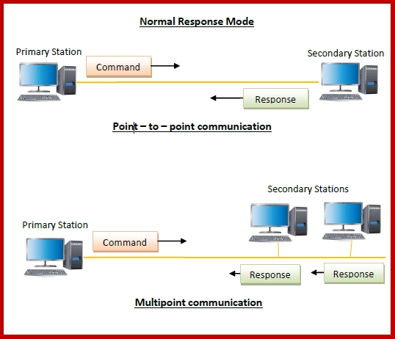
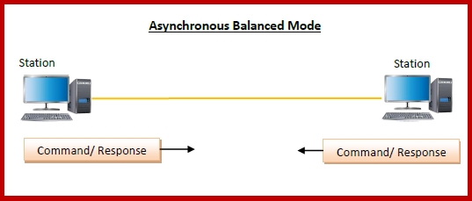

Slide 29
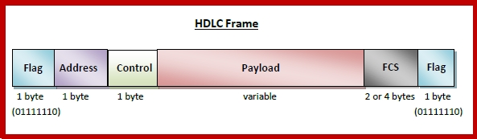
HDLC Frame
HDLC is a bit - oriented protocol where each frame contains up to six fields. The structure varies according to the type of frame. The fields of a HDLC frame are −
Flag − It is an 8-bit sequence that marks the beginning and the end of the frame. The bit pattern of the flag is 01111110.
Address − It contains the address of the receiver. If the frame is sent by the primary station, it contains the address(es) of the secondary station(s). If it is sent by the secondary station, it contains the address of the primary station. The address field may be from 1 byte to several bytes.
Control − It is 1 or 2 bytes containing flow and error control information.
Payload − This carries the data from the network layer. Its length may vary from one network to another.
FCS − It is a 2 byte or 4 bytes frame check sequence for error detection. The standard code used is CRC (cyclic redundancy code)

Slide 30
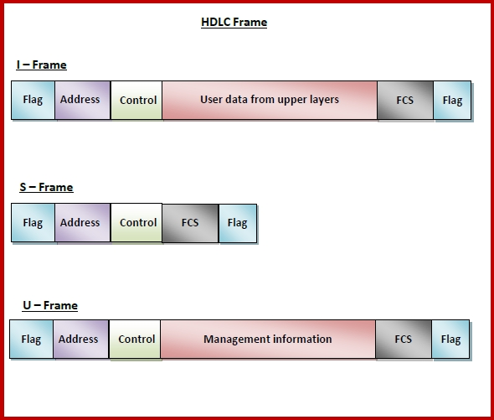
Types of HDLC Frames
There are three types of HDLC frames. The type of frame is determined by the control field of the frame −
I-frame − I-frames or Information frames carry user data from the network layer. They also include flow and error control information that is piggybacked on user data. The first bit of control field of I-frame is 0.
S-frame − S-frames or Supervisory frames do not contain information field. They are used for flow and error control when piggybacking is not required. The first two bits of control field of S-frame is 10.
U-frame − U-frames or Un-numbered frames are used for myriad miscellaneous functions, like link management. It may contain an information field, if required. The first two bits of control field of U-frame is 11.

Slide 31
HDLC Operation:
Frame Transmission:
The sender transmits a frame that includes the flag, address, control, information, FCS, and another flag.
The receiver checks for the flag to identify the start and end of the frame. The control field is analyzed for sequence and acknowledgment information.
Error Detection:
The receiver computes the CRC of the received frame. If the CRC doesn’t match the received FCS, an error is detected, and the frame is discarded.
A request for retransmission is made if the frame is found to be in error.
Acknowledgement:
For I-Frames, the receiver sends an acknowledgment (ACK) to the sender indicating whether the data was successfully received. The acknowledgment may include a sequence number for the frame.
For S-Frames, the receiver might send an ACK or NAK (Negative Acknowledgment) based on the condition of the received frame.
Flow Control:
HDLC can implement flow control mechanisms to ensure that the sender does not overwhelm the receiver by sending too many frames at once.
The control field in supervisory frames helps manage flow by preventing the receiver's buffer from overflowing.
Link Management:
U-Frames are used for controlling the state of the link (i.e., when to initiate or terminate a connection). These are also used to reset the link or request information on link status.

Slide 32
Applications of HDLC:
ISDN (Integrated Services Digital Network): Used for data transmission over digital networks.
Frame Relay: Used in wide area networks (WANs) for transferring data across leased lines.
ATM (Asynchronous Transfer Mode): HDLC is used for encapsulating data in some ATM networks.
Synchronous Serial Links: HDLC is commonly used in point-to-point communication links, such as PPP (Point-to-Point Protocol), X.25, and HDLC-based Frame Relay.

Slide 33
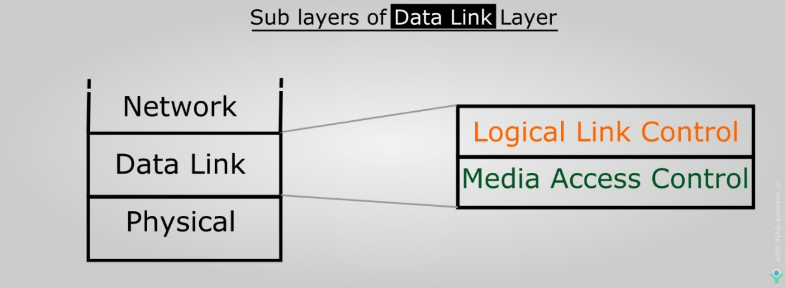
LLC and MAC Sublayer
The Data Link Layer (Layer 2) of the OSI model is responsible for node-to-node communication and error handling in a network. This layer is divided into two main sublayers:
1. MAC Sublayer (Media Access Control):
The MAC sublayer is responsible for controlling access to the physical transmission medium. It handles the framing, addressing, and access mechanisms for data transfer over the physical layer.
2. LLC Sublayer (Logical Link Control):
The LLC sublayer sits above the MAC sublayer and provides a standardized interface for communication between the data link layer and the network layer. It is responsible for logical link control and provides mechanisms for error handling, flow control, and multiplexing different network layer protocols.

Slide 34
Logic Link Control Sublayer
The Logical Link Control (LLC) layer is the upper sublayer of the Data Link Layer (Layer 2) in the OSI model.
It plays a crucial role in providing a standardized interface for communication between the network layer (Layer 3) and the MAC (Media Access Control) sublayer of the Data Link Layer.
Overview of the LLC Sublayer:
The LLC sublayer is responsible for handling logical communication between devices over the physical network, ensuring reliable data transfer, and managing the flow of data. It defines the interface that the network layer uses to interact with the data link layer, and it supports multiple network layer protocols over the same physical link.

Slide 35
Functions of LLC
1. Multiplexing:
The LLC sublayer allows different network protocols to share the same data link.
It uses Service Access Points (SAPs) to distinguish between different network layer protocols (such as IP, IPX, or AppleTalk). Each network layer protocol is associated with a unique SAP, so the LLC can direct data to the correct protocol.
Example: On an Ethernet network, data from both IP and IPX can be transmitted over the same physical medium, and the LLC sublayer ensures that each protocol's data is correctly passed to the respective network layer.
2. Error Control:
The LLC sublayer provides optional error detection for data frames that are transmitted over the network.
Error detection is typically achieved using Cyclic Redundancy Check (CRC). If the receiver detects errors in a frame (using CRC), it can discard the frame and request a retransmission, ensuring data integrity.
3. Flow Control:
Flow control mechanisms in the LLC sublayer manage the rate at which data is transmitted between sender and receiver, preventing the receiver from being overwhelmed with too much data at once.
This can be implemented by regulating the window size in the case of connection-oriented communication (Type 2 LLC).

Slide 36
4. Frame Sequencing:
The LLC sublayer ensures that frames are delivered in the correct sequence. This is important when a stream of data is being transmitted and when data loss or reordering could occur in unreliable networks.
It uses sequence numbers to track frames, and the Type 2 LLC provides acknowledgments for correctly received frames, helping to reassemble the original data stream.
5. Logical Link Establishment, Maintenance, and Termination:
The LLC sublayer manages the establishment, maintenance, and termination of logical links between devices.
It provides services to the network layer and ensures that the communication link remains open and operational for the duration of the session.

Slide 37
LLC Frame Structure
An LLC frame is encapsulated within the Data Link Layer frame and includes several fields for identifying and managing communication. The structure of an LLC frame typically includes:
DSAP (Destination Service Access Point):
A 1-byte field that identifies the destination service access point.
It specifies which network layer protocol (e.g., IP, IPX) the frame is intended for.
SSAP (Source Service Access Point):
A 1-byte field that identifies the source service access point.
It specifies the network layer protocol from which the frame is being sent.
Control Field:
A 1-byte field that defines the type of LLC frame. It specifies whether the frame is an Information Frame (I-Frame), a Supervisory Frame (S-Frame), or an Unnumbered Frame (U-Frame).
The Control Field helps manage the flow of data, error checking, and the acknowledgment process.
Information Field:
The actual payload or data that is being transferred by the frame. This field contains the network layer data (e.g., an IP packet).
This field’s size depends on the data being sent.
FCS (Frame Check Sequence):
A 2-byte or 4-byte field used for error detection.
The FCS is computed using CRC over the entire frame (excluding the flag) and is used by the receiver to detect errors during transmission.

Slide 38
Types of LLC Frame
Information Frame (I-Frame):
Used to carry data between devices in a connection-oriented or connectionless manner.
It contains sequence numbers to maintain the order of frames and ensure reliable delivery.
Acknowledgments are typically sent by the receiver to confirm successful reception.
Supervisory Frame (S-Frame):
Used for flow control, error reporting, and acknowledgment.
It helps manage the flow of data by allowing the sender to pause or resume the transmission based on the receiver's capacity to process the data.
It can also be used to acknowledge the receipt of I-Frames or request retransmissions if an error occurs.
Unnumbered Frame (U-Frame):
Used for link management purposes, such as establishing or terminating a logical link.
U-Frames are also used for functions like resetting the link, querying the status, or negotiating parameters.

Slide 39
LLC Protocols
The IEEE 802.2 standard defines two different types of LLC services based on how the logical link is managed:
Type 1 (Unacknowledged Connectionless Service):
This type does not provide acknowledgments or error recovery. It is used when the sender does not require confirmation of data delivery. This is typically used in situations where low overhead is preferred and occasional data loss is acceptable (e.g., real-time communication, live video/audio streaming).
Type 2 (Acknowledged Connection-Oriented Service):
This type provides acknowledgments and ensures reliable data delivery, including error control and flow control.
It guarantees that the data is delivered in order and without errors, making it suitable for reliable communication (e.g., TCP for connection-oriented communication).
The sender waits for an acknowledgment after sending a frame, and if no acknowledgment is received (due to errors), the frame is retransmitted.

Slide 40
Media Access Control (MAC) Sublayer
The Media Access Control (MAC) sublayer is the lower sublayer of the Data Link Layer (Layer 2) in the OSI (Open Systems Interconnection) model.
The MAC sublayer is responsible for controlling access to the physical transmission medium and managing how data is transmitted over the network.
It plays a crucial role in determining when and how devices on the same network can send and receive data, ensuring that data transmission is coordinated, efficient, and collision-free (or collision-avoiding, depending on the protocol).

Slide 41
Key Functions of MAC Sublayer
Frame Framing:
The MAC sublayer adds its own header and trailer to the data received from the Logical Link Control (LLC) sublayer. This forms a complete data frame that can be transmitted over the network.
The frame contains essential information, including MAC addresses (source and destination) and a Frame Check Sequence (FCS) for error detection.
MAC Addressing:
The MAC sublayer uses MAC addresses (also known as physical addresses) to uniquely identify devices on a local network. These 48-bit addresses are assigned to network interfaces at the time of manufacture and are globally unique.
Each frame transmitted by a device contains the destination MAC address (the address of the device intended to receive the data) and the source MAC address (the address of the sending device).
Media Access Control:
The MAC sublayer is responsible for controlling access to the shared communication medium, especially in network environments where multiple devices are connected to the same medium (e.g., Ethernet or Wi-Fi).
It manages how devices take turns to transmit data, preventing conflicts such as collisions (when two devices try to send data at the same time).

Slide 42
Collision Detection and Avoidance:
In shared mediums, there is a risk that two devices might send data at the same time, resulting in a collision. The MAC sublayer must handle this.
Collision Detection: In technologies like Ethernet (using CSMA/CD, or Carrier Sense Multiple Access with Collision Detection), the sender listens to the network before transmitting to ensure the medium is idle. If a collision occurs, the sender waits for a random time before retrying.
Collision Avoidance: In wireless networks (like Wi-Fi), CSMA/CA (Carrier Sense Multiple Access with Collision Avoidance) is used, which involves devices waiting for a random backoff period to avoid collisions.
Frame Error Detection:
The MAC sublayer is responsible for error detection in transmitted frames. It includes a Frame Check Sequence (FCS) field in the frame's trailer, which uses a Cyclic Redundancy Check (CRC) to check for errors during transmission.
If a frame is corrupted, it is discarded, and the receiver requests a retransmission (if needed).
Flow Control:
Some MAC sublayers implement flow control, ensuring that the sender does not overwhelm the receiver with more data than it can handle.
For example, Ethernet does not have built-in flow control, while Wi-Fi (IEEE 802.11) implements a form of flow control through the RTS/CTS (Request to Send/Clear to Send) mechanism.

Slide 43
MAC Frame Structure
An MAC frame contains several components, including the MAC header, the payload (network data), and the trailer. Here is a typical structure for an Ethernet MAC frame:
Preamble: (Only in Ethernet)
A sequence of bits (7 bytes) used to synchronize the communication between the sender and receiver.
Start of Frame Delimiter (SFD): (Only in Ethernet)
Marks the beginning of the actual frame (after the preamble).
Destination MAC Address: (6 bytes)
The MAC address of the device that is intended to receive the frame.
Source MAC Address: (6 bytes)
The MAC address of the device that is sending the frame.
Length/Type: (2 bytes)
This field can either specify the length of the data field or the type of protocol being carried (e.g., IP, ARP).
Data (Payload):
The actual data being transmitted, typically an IP packet, network layer data, or higher-layer data.
The size of the data field can vary, but it typically ranges from 46 to 1500 bytes in Ethernet.
Frame Check Sequence (FCS): (4 bytes)
The CRC value used for error detection. The receiver computes the CRC over the frame and compares it to the FCS value to verify that the data has not been corrupted.
End of Frame: (Only in Ethernet)
The frame ends with the SFD to ensure the frame’s boundaries are detected.

Slide 44
Random Access Protocol
In Random Access methods, there is no station that is superior to another station and none is assigned control over the other. It simply means that there is no station that permits another station to send.
A station that has the data to send mainly makes the use of a procedure that is defined by the protocol in order to make a decision whether to send or not to send the data.
And the decision mainly depends upon the state of the medium as a medium can either be idle or it can be busy.
There is no time scheduled for any station in order to transmit the data, the transmission is random among all stations; that is why these methods are called random access.
There are no rules regarding which station should send the data next, all stations compete with one another in order to access the medium. Thus these methods are also referred to as Contention methods.
In case if there are two or more stations that try to send the data, there occurs a conflict in the access and it is referred to as Collision.

Slide 45
Given below are the protocols that lie under the category of Random Access Protocols:
ALOHA(Pure ALOHA and slotted ALOHA)
CSMA
CSMA/CD
CSMA/CA

Slide 46
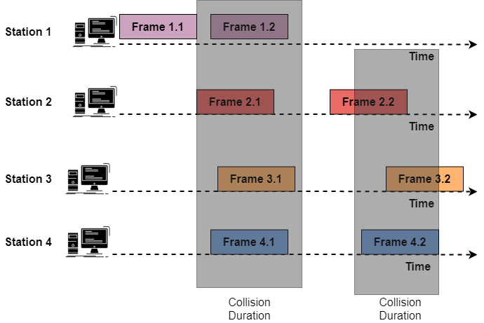
Pure ALOHA
This protocol is very simple but elegant at the same time.
The main idea behind this protocol is that each station sends a frame whenever it has a frame to send.
As we have already told you that the medium is shared among different stations, thus there is a possibility of collision between frames from the different stations.
Let us now take a look at the frames in a pure ALOHA network:

Slide 47
The above figure shows that there are 4 stations and each station sends two frames, thus there is a total of 8 frames on the shared medium. Among these 8 frames, there are some frames that collide with each other.
Thus there is the only frame that is frame 1.1 from station 1 that survives.
We need to resend those frames that have been destroyed during the transmission. The pure ALOHA method depends upon the acknowledgment from the receiver, whenever any station sends a frame, then it expects the receiver to send an acknowledgment. If there is no arrival of acknowledgment after the time-out period then the station assumes that the frame or the acknowledgment gets destroyed and in this way, it resends the frame.
In the collision there is mainly the involvement of two or more stations, in case if all the stations try to resend the frames after the time-out period passes then all the frames will collide again.
Thus in Pure ALOHA, when the time-out period passes then each station waits for a random amount of time before resending its frame and this randomness helps to avoid more collisions and this time is referred to as back-off time (TB).
Given below is the procedure used for Pure ALOHA protocol:

Slide 48
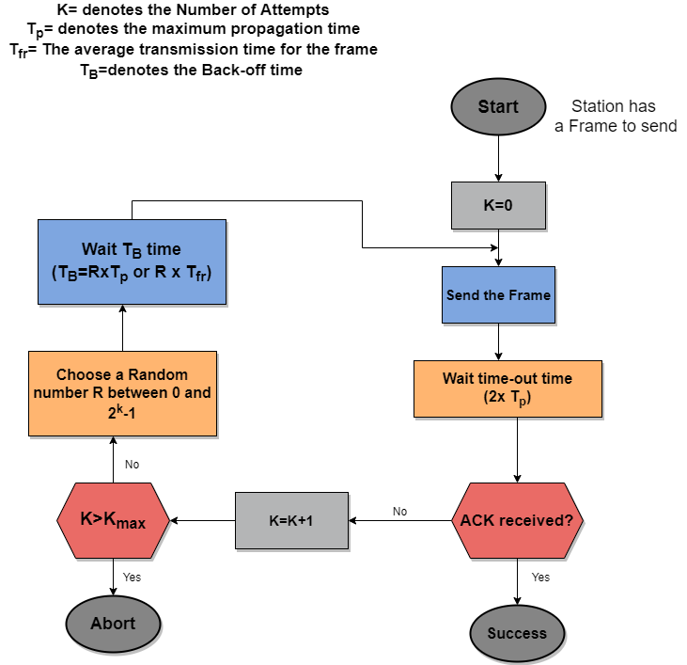

Slide 49
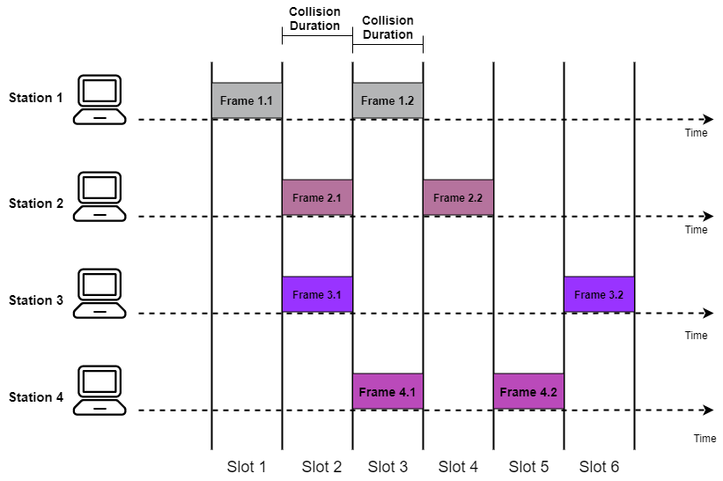
Slotted ALOHA
As the name suggests, in the slotted ALOHA the time of the shared channel is simply divided into discrete intervals that are commonly known as Time Slots.
In Slotted ALOHA it is imposed on each station to send the data only at the beginning of the time slot.
As a station is allowed to send the data only at the beginning of the time slot, in case if any station misses this moment then it must have to wait until the beginning of the next time slot.
In case if two stations try to send at the beginning of the same time slot then there are chances for the occurrence of the collision

Slide 50
Pure ALOHA vs Slotted ALOHA
Pure ALOHA | Slotted ALOHA
In the Pure ALOHA, the station can transmit the data frame whenever the station has data to send. | In this, the station can transmit the data only at the beginning of the time slot.
In the case of Pure ALOHA, the time is continuous | In the case of Slotted ALOHA, the time is discrete and is in the form of time slots.
One of the main advantages of using Pure ALOHA is that the implementation of this method is simple. | One of the main advantages of using the slotted ALOHA is that there is a reduction in the number of collisions and there is an increase in efficiency as compared to Pure ALOHA. In simple terms, collisions are reduced to half while the efficiency increases to double.
The efficiency offered by the Pure ALOHA is 18.4%. | The Efficiency offered by the slotted ALOHA is 36.8%
The probability of the successful transmission of the data packet is equals to G x e-2G | The probability of the successful transmission of the data packet is equals to G x e-G
The Vulnerable time offered by the Pure ALOHA is 2 x T fr | The Vulnerable time offered by the slotted ALOHA is T fr

Slide 51
Carrier Sense Multiple Access (CSMA).
CSMA stands for Carrier Sense Multiple Access (CSMA). CSMA is one of the network protocols which works on the principle of ‘carrier sense’. CSMA is a protocol developed to increase the performance of the network and reduce the chance of collision in the network.
If any device wants to send data then the device first senses or listens to the network medium to check whether the shared network is free or not. If the channel is found idle then the device will transmit its data.
This sense reduces the chance of collision in the network but this method is not able to eliminate the collision.
Carrier Sense Multiple Access (CSMA) is a protocol that senses or listens to the medium before any transmission of data in the medium.
CSMA is used in Ethernet networks where two or more network devices are connected.

Slide 52
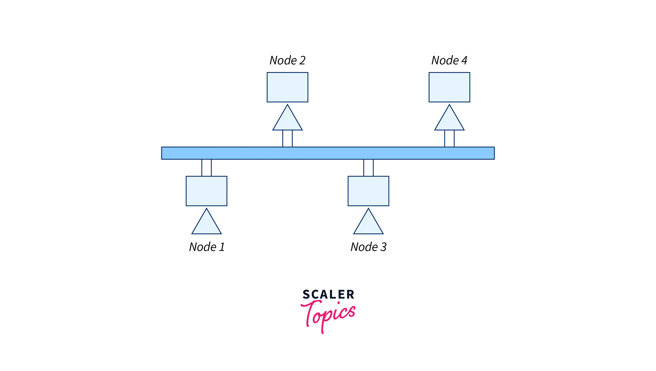

Slide 53
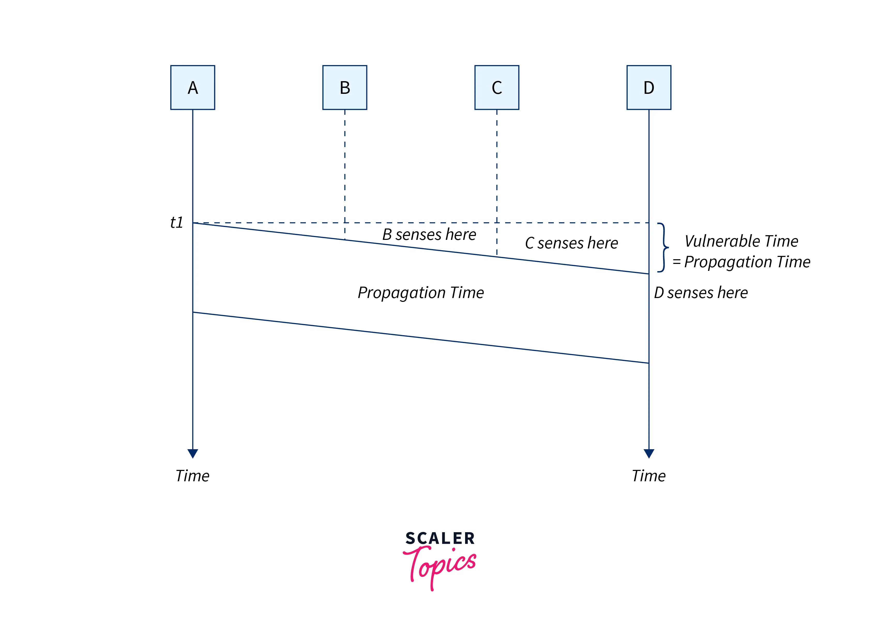
Vulnerable Time in CSMA
In the CSMA vulnerable time is considered as the propagation time and Tp is used to denote it. Generally, it is the time taken by the data frame to reach from one end of the channel to another end. When two stations send the data simultaneously then it will result in a collision in the network. In a situation, if the first bit of the frame sent by the station reaches the end of the shared medium then every station connected in a network hears that bit and every device in the network refrains from sending it.
Refer to the below image for the vulnerable time of CSMA

Slide 54
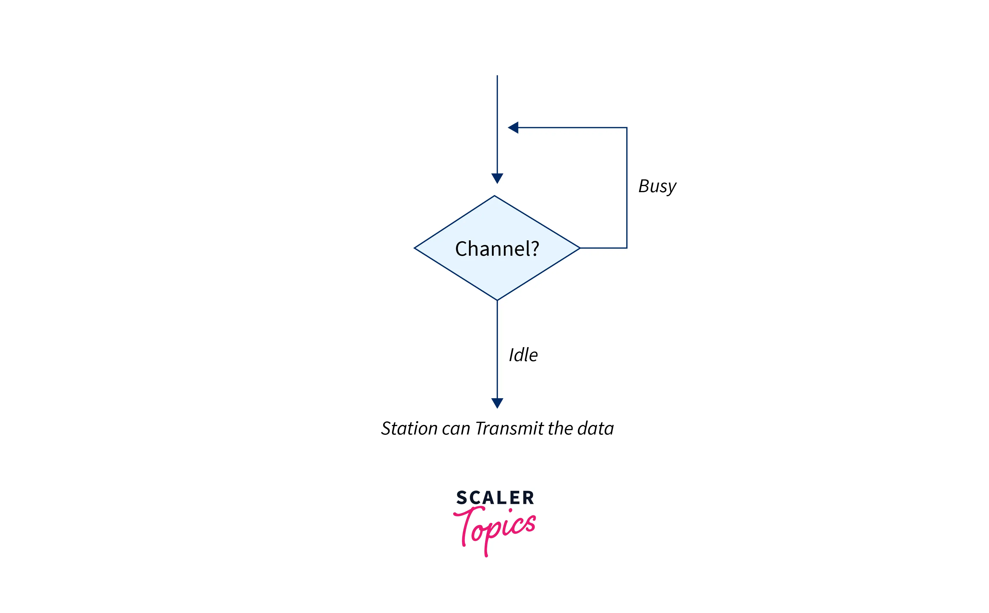
Types of CSMA Access Modes
1-Persistent
This method is considered the straightforward and simplest method of CSMA. In this method, if the station finds the medium idle then the station will immediately send the data frame with 1- probability.
In this, if the station wants to transmit the data. Then the station first senses the medium.
If the medium is busy then the station waits until the channel becomes idle. And the station continuously senses the channel until the medium becomes idle.
If the station detects the channel as idle then the station will immediately send the data frame with 1 probability that’s why the name of this method is 1-persistent.

Slide 55
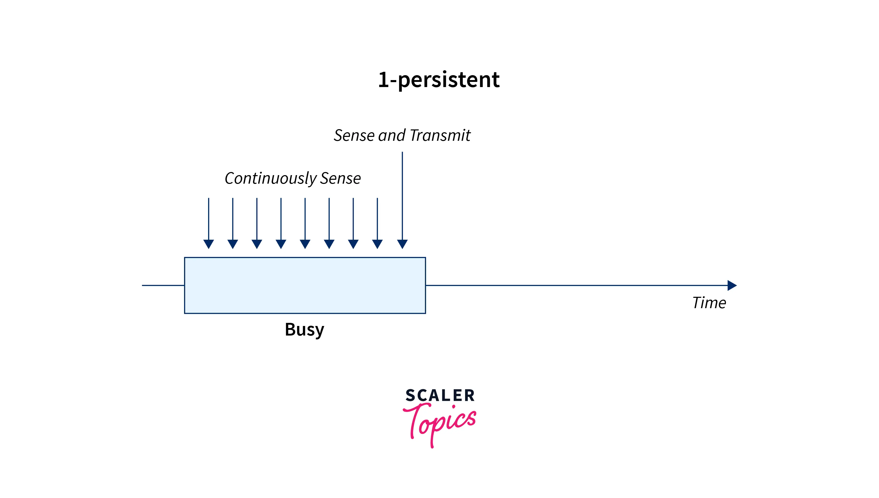
In this method, there is a high possibility of collision as two or more station senses the channel idle at the same time and transmits data simultaneously which may lead to a collision. This is one of the most straightforward methods. In this method, once the station finds that the medium is idle then it immediately sends the frame. By using this method there are higher chances for collision because it is possible that two or more stations find the shared medium idle at the same time and then they send their frames immediately.

Slide 56
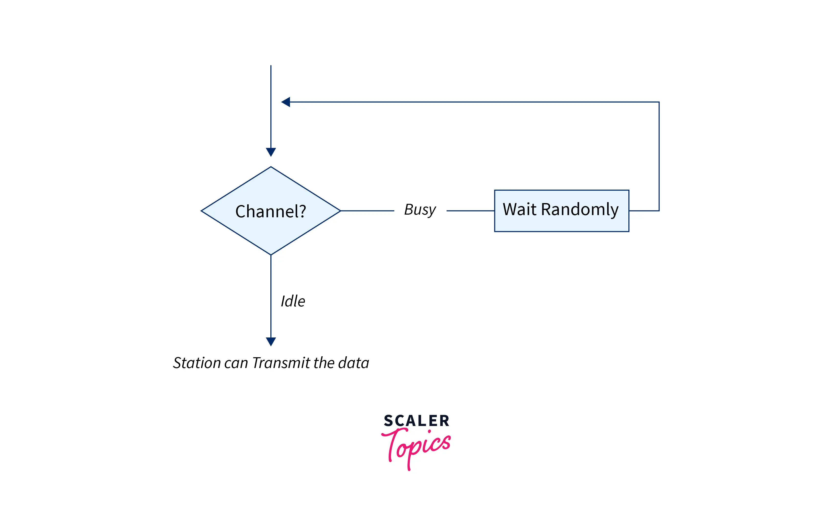
Non-Persistent
In this method of CSMA, if the station finds the channel busy then it will wait for a random amount of time before sensing the channel again.
If the station wants to transmit the data then first of all it will sense the medium.
If the medium is idle then the station will immediately send the data.
Otherwise, if the medium is busy then the station waits for a random amount of time and then again senses the channel after waiting for a random amount of time.
In P-persistent there is less chance of collision in comparison to the 1-persistent method as this station will not continuously sense the channel but since the channel after waiting for a random amount of time.

Slide 57
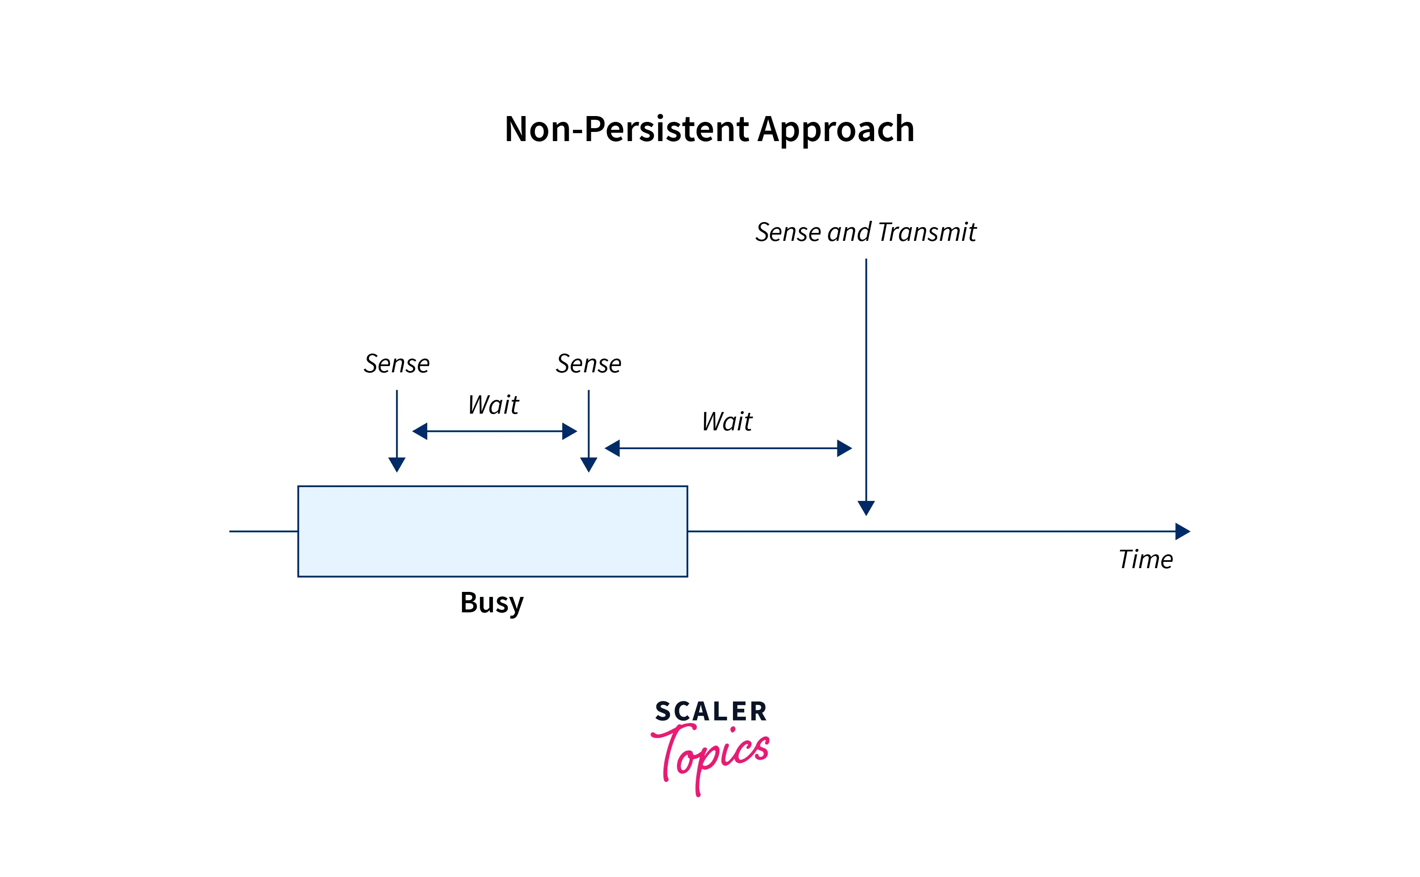
So the random amount of time is unlikely to be the same for two stations that’s why this method reduces the chance of collision.

Slide 58
P-Persistent
The p-persistent method of CSMA is used when the channel is divided into multiple time slots and the duration of time slots is greater than or equal to the maximum propagation time. This method is designed as a combination of the advantages of 1-Persistent and Non-Persistent CSMA. The p-persistent method of CSMA reduces the chance of collision in the network and there is an increment in the efficiency of the network. When any station wants to transmit the data firstly it will sense the channel If the channel is busy then the station continuously senses the channel until the channel becomes idle. If the channel is idle then the station does the following steps.
The station transmits its data frame in the network by p probability.
The station waits for the start of the next time slot with probability q=1-p and after waiting again senses the channel.
If the channel is again idle, then it again performs step 1. If the channel is busy, then it thinks that there is a collision in the network and now this station will follow the back-off procedure.

Slide 59
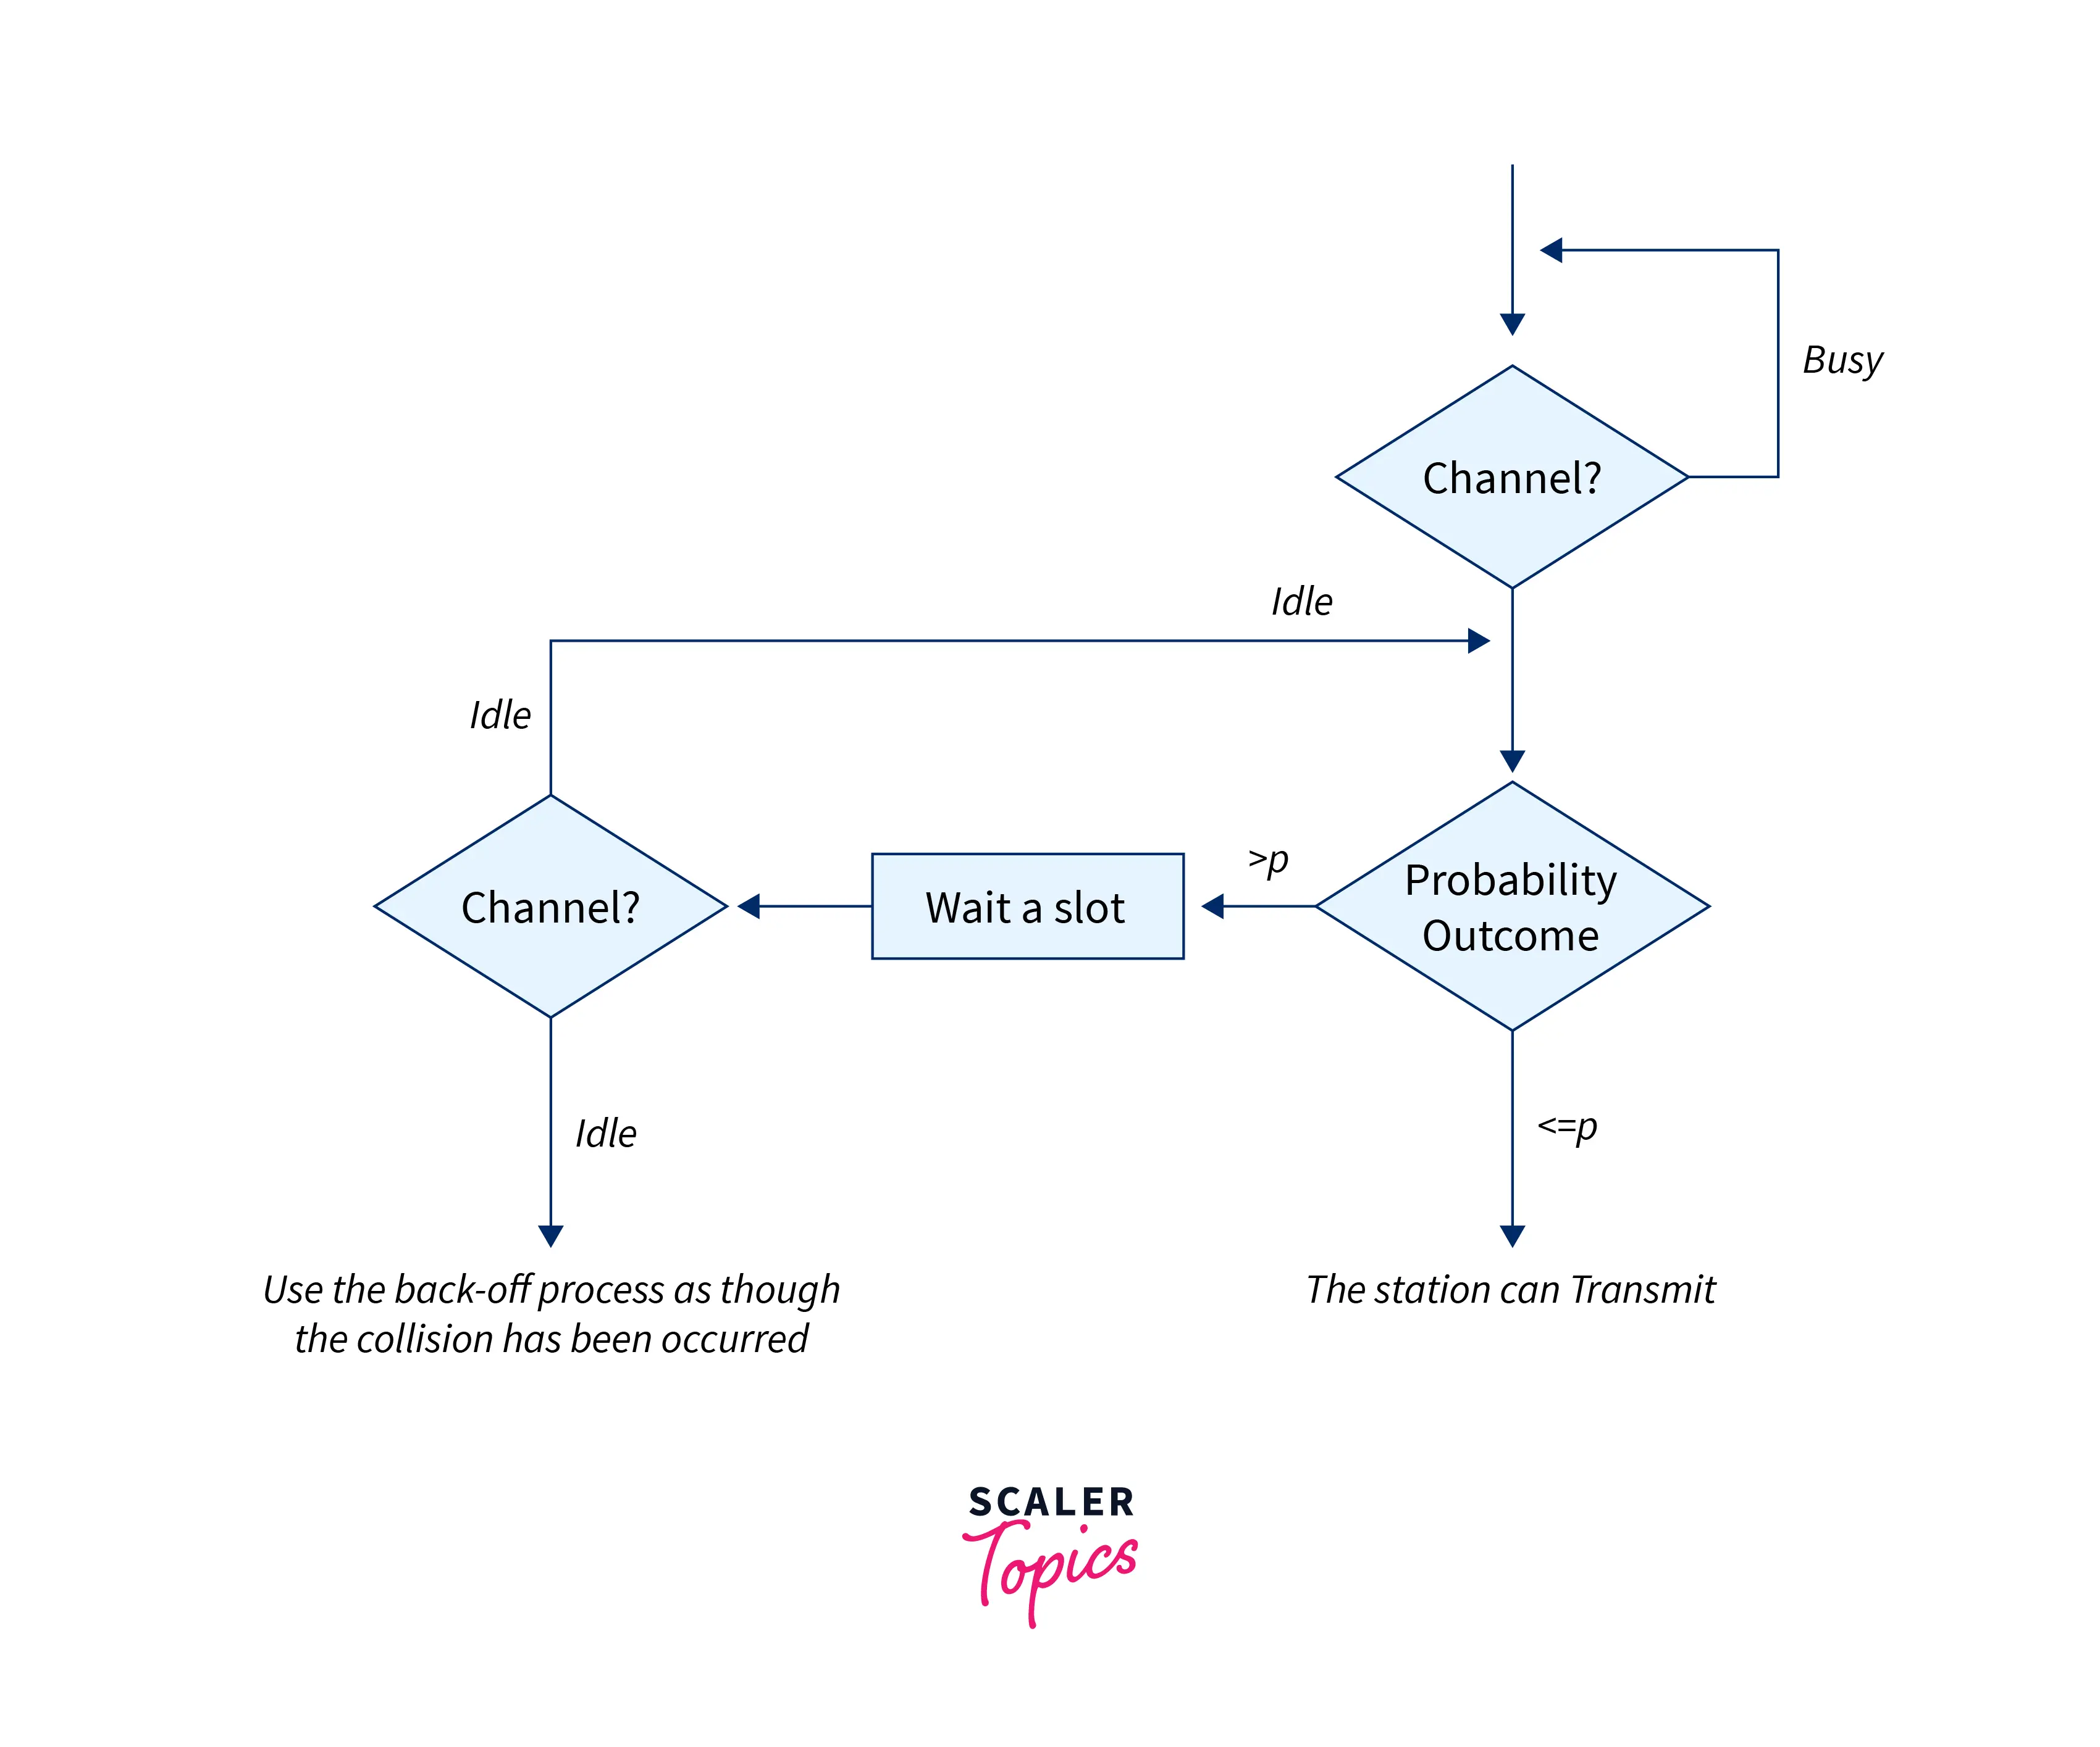

Slide 60
O-Persistent
In this method of CSMA supervisory node assigns a transmission order to each node in the network. When the channel is idle instead of immediately sending the data channel will wait for its transmission order assigned to them.
This mode of CSMA defines the superiority of the station before data transmission in the medium. In this mode, if the channel is inactive then all stations will wait to transmit the data for its turn. Every station in the channel transmits the data in its turn.

Slide 61
CSMA CD
The network protocol for carrier transmission known as CSMA/CD (Carrier Sense Multiple Access with Collision Detection) runs at the Medium Access Control (MAC) layer.
The shared channel for communication is detected or heard, and transmissions are postponed until the channel is clear.
By detecting transmissions from other stations, the collision detection technique finds collisions. When a collision is detected, the station immediately ceases transmission, broadcasts a jam signal, and thereafter waits for a random amount of time before retransmission.

Slide 62
How it works??
The CSMA/CD algorithm are:
The transmitting station determines whether the channel is busy or idle when a frame is ready.
If the channel is occupied, the station waits till it is free.
The station begins transmitting and continuously scans the channel for collisions if the channel is empty.
The station begins the collision resolution mechanism when a collision is detected.
After finishing frame transmission, the stations reset the retransmission counters.
The collision resolution algorithm are:
In order to make sure that all other stations notice a collision, the station keeps transmitting the current frame for a predetermined amount of time while also sending out a jam signal.
The station increases the retransmission counter.
The station stops transmission if the allotted number of retransmission attempts has been used.
In the absence of a restart main algorithm, the station waits for a backoff period, which is often a function of the number of collisions

Slide 63
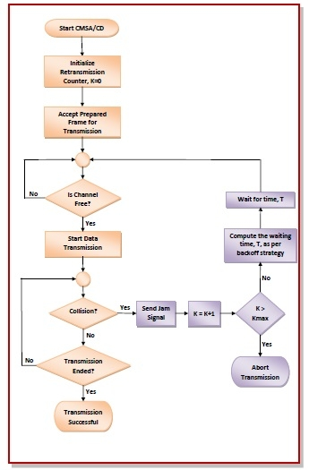

Slide 64
CSMA/CA
CSMA/CA is a network access method used mainly in Wi-Fi (IEEE 802.11) to reduce collisions before they occur, because Wi-Fi devices generally cannot detect collisions while transmitting (no CD like Ethernet).
CSMA/CA uses acknowledgements like CSMA. Each frame contains a sequence number and a CRC. The CRC is used to detect transmission errors while the sequence number is used to avoid frame duplication. When a device receives a correct frame, it returns a special acknowledgement frame to the sender.
CSMA/CA introduces a small delay, named Short Inter Frame Spacing (SIFS), between the reception of a frame and the transmission of the acknowledgement frame. This delay corresponds to the time that is required to switch the radio of a device between the reception and transmission modes.

Slide 65
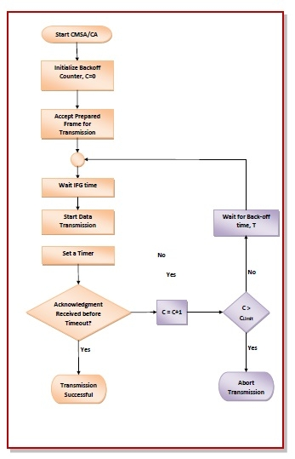
Working of CSMA/CA (Step-by-Step)
1. Carrier Sensing
The station checks whether the wireless channel is idle or busy.
2. Wait for Interframe Space (IFS)
If the channel is free, the device waits for a time interval such as:
DIFS (Distributed Interframe Space) in Wi-Fi
3. Backoff Mechanism
To reduce the chance of two devices transmitting simultaneously:
A random backoff counter is chosen.
The counter decreases only when the channel is idle.
If someone else transmits, the counter pauses.

Slide 66
4. Frame Transmission
When the backoff timer reaches zero → the device transmits.
5. Acknowledgement (ACK)
The receiver sends an ACK frame confirming successful delivery.
No ACK → transmission assumed failed → start backoff again.
6. Collision Avoidance
Because Wi-Fi can't detect collisions during transmission, avoiding them is essential:
Random backoff time
Optional RTS/CTS handshake

Slide 67
Token based protocols
Token-based protocols are controlled access protocols used in computer networks to regulate how multiple nodes share a common transmission medium.
A special control frame called a token is continuously passed from one node to another in a predefined order (usually a logical ring).
👉 Only the node that currently holds the token is permitted to transmit data. If a node does not have the token, it must remain silent, even if the channel is idle.
This strict rule completely prevents collisions, unlike random access protocols such as CSMA/CD, where multiple devices may attempt to transmit simultaneously, causing collisions and retransmissions.

Slide 68
Why token-based protocols exist
Token protocols were created to overcome serious limitations of random access methods:
1. Collision elimination
In CSMA/CD, collisions waste bandwidth and increase delay. In token-based protocols:
Only one node transmits at a time
No two nodes can transmit simultaneously ➡ Collisions are completely eliminated
2. Fair access to the medium
Random access methods do not guarantee fairness. A busy node may dominate the channel while others starve.
In token-based systems:
The token is passed sequentially
Every node gets an equal opportunity to transmit ➡ Starvation is impossible
3. Predictable and bounded delay
In real-time systems (industrial control, aviation, medical systems), unpredictable delay is unacceptable.
With token passing:
Maximum waiting time = time for token to complete one full cycle
Delay can be calculated in advance ➡ Deterministic behaviour is guaranteed
This is the main technical advantage of token-based protocols.

Slide 69
How token-based protocols work (step-by-step elaboration)
Step 1: Token circulation
A token frame (a small control packet) continuously circulates among all nodes in the network following a logical order (e.g., Node A → B → C → D → A).
This token contains control information, not user data.
Step 2: Token reception
When a node receives the token:
It checks whether it has data to send
If it has no data, it immediately passes the token to the next node
If it has data, it captures the token
This decision happens very fast to avoid unnecessary delay.
Step 3: Token capture and data transmission
If the node has data:
It seizes the token
Converts it from a free token into a busy token
Transmits data frames onto the network
To prevent monopolisation:
Transmission is limited by time (token holding time) or frame count
This ensures fairness.
Step 4: Release of the token
After transmission:
The node releases the token
Either by regenerating a free token
Or by modifying the busy token back into a free token
This signals that the medium is available again.
Step 5: Token passes to the next node
The released token moves to the next node in the logical sequence.
The cycle continues indefinitely, ensuring:
Orderly access
Zero collisions
Predictable delays

Slide 70
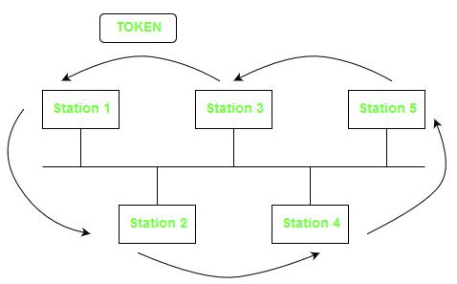
Token Bus (IEEE 802.4)
Token Bus (IEEE 802.4) is a popular standard for token passing LANs. In a token bus LAN, the physical media is a bus or a tree, and a logical ring is created using a coaxial cable. The token is passed from one user to another in a sequence (clockwise or anticlockwise). Each station knows the address of the station to its "left" and "right" as per the sequence in the logical ring. A station can only transmit data when it has the token. The working of a token bus is somewhat similar to Token Ring.
The Token Bus (IEEE 802.4) is a standard for deploying token rings in LANs over a virtual ring. The physical medium uses coaxial cables and has a bus or tree architecture. The nodes/stations form a virtual ring, and the token is transmitted from one node to the next in a sequence along the virtual ring. Each node knows the address of the station before it and the station after it. When a station has the token, it can only broadcast data. The token bus works in a similar way as the Token Ring.

Slide 71
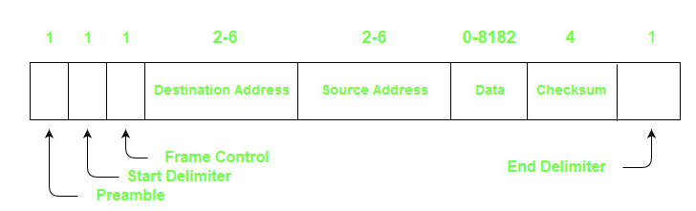
Frame Format
Preamble - It is used for bit synchronization. It is a 1-byte field.
Start Delimiter - These bits mark the beginning of the frame. It is a 1-byte field.
Frame Control - This field specifies the type of frame - data frame and control frames. It is a 1-byte field.
Destination Address - This field contains the destination address. It is a 2 to 6 bytes field.
Source Address - This field contains the source address. It is a 2 to 6 bytes field.
Data - If 2-byte addresses are used then the field may be up to 8182 bytes and 8174 bytes in the case of 6-byte addresses.
Checksum - This field contains the checksum bits which are used to detect errors in the transmitted data. It is 4 bytes field.
End Delimiter - This field marks the end of a frame. It is a 1-byte field.

Slide 72
Characteristics
Bus Topology: Token Bus uses a bus topology, where all devices on the network are connected to a single cable or "bus".
Token Passing: A "token" is passed around the network, which gives permission for a device to transmit data.
Priority Levels: Token Bus uses three priority levels to prioritize data transmission. The highest priority level is reserved for control messages and the lowest for data transmission.
Collision Detection: Token Bus employs a collision detection mechanism to ensure that two devices do not transmit data at the same time.
Maximum Cable Length: The maximum cable length for Token Bus is limited to 1000 meters.
Data Transmission Rates: Token Bus can transmit data at speeds of up to 10 Mbps.
Limited Network Size: Token Bus is typically used for small to medium-sized networks with up to 72 devices.
No Centralized Control: Token Bus does not require a central controller to manage network access, which can make it more flexible and easier to implement.
Vulnerable to Network Failure: If the token is lost or a device fails, the network can become congested or fail altogether.
Security: Token Bus has limited security features, and unauthorized devices can potentially gain access to the network.

Slide 73
Advantages and Disadvantages
Advantages:
Token Bus provides a fair access mechanism, which ensures that each device gets an equal opportunity to transmit data.
It supports a large number of nodes (up to 72 nodes), which makes it suitable for use in large networks.
Token Bus is a deterministic protocol, which means that the time required for a device to access the network is predictable.
It provides a high level of reliability and fault tolerance, as a single point of failure (such as a broken cable) does not affect the entire network.
Token Bus is a standardized protocol, which ensures interoperability between devices from different vendors.
Disadvantages:
Token Bus has a relatively low data transfer rate compared to other LAN protocols, such as Ethernet.
It requires a strict physical layout of the network, with a maximum length of 2500 meters and a maximum of 8 taps (devices) between any two active nodes.
Token Bus has a complex protocol, which requires a high level of expertise to design and implement.
It is susceptible to collisions, as multiple devices may try to access the network at the same time.
Token Bus requires a dedicated token, which can result in increased latency and decreased network performance.

Slide 74
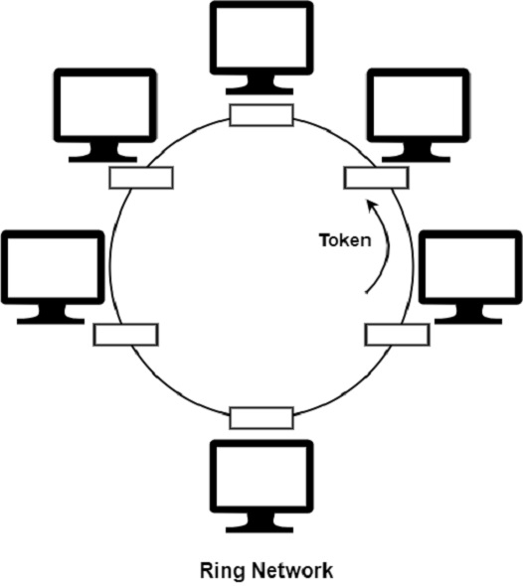
Token Ring Network (IEEE Standard 802.5)
In a token ring, a special bit pattern, known as a token, circulates around the ring when all the stations are idle. Token Ring is formed by the nodes connected in ring format, as shown in the diagram below.
The principle used in the token ring network is that a token is circulating in the ring, and whichever node grabs that token will have the right to transmit the data.
Whenever a station wants to transmit a frame, it inverts a single bit of the 3-byte token, which instantaneously changes it into a normal data packet. As there is only one token, there can be only one transmission at a time.
Since the token rotates in the ring, it is guaranteed that every node gets the token within some specified time. So there is an upper bound on the time of waiting to grab the token so that starvation is avoided. There is also an upper limit of 250 on the number of nodes in the network.
The ring network is depicted in the figure given below

Slide 75
Token Ring Frame
Start Delimiter (SD) 1 Byte : Used for the marking the beginning of the frame. This has a unique bit pattern so that the receiving station knows exactly when a new frame starts. It includes symbols to indicate timing and frame synchronization.
Access Control (AC) 1 Byte : Used to manage token passing and transmission control. Fields Include:
Priority bits (3 bits): Used to determine the priority of the frame.
Token bit (T): Indicates whether the frame is a token or data.
Monitor bit (M): Ensures only one token exists in the ring.
Reservation bits (3 bits): Allow a station to reserve the token for higher priority transmissions.

Slide 76
Frame Control (FC) 1 Byte : It identifies the type of frame being transmitted. It helps devices interpret the rest of the frame correctly. First 2 bits indicates whether the frame contains data or control information. In control frames, this byte specifies the type of control information.Types:
Data Frame: Carries user data.
MAC Frame: Used for control purposes such as ring maintenance.
Destination Address (DA) 2 or 6 Bytes : It specifies the intended receiver’s MAC address. The size depends on whether the network uses 16-bit or 48-bit addressing. This allows unicast, multicast, or broadcast communication.
Source Address (SA) 2 or 6 Bytes : It contains the MAC address of the sender. It has the same size as the destination address.
Data Variable Length : It carries the actual message or payload. It sizes typically up to 4,000 bytes, but can vary based on network configuration. This is the information the sender wants to deliver.
Frame Check Sequence (FCS) 4 Bytes : Used for error-checking using Cyclic Redundancy Check (CRC). It ensures the data was not corrupted in transit. The recipient recalculates the CRC and compares it to detect any errors. 32 bit CRC which is used to check for errors in the frame, i.e., whether the frame is corrupted or not. If the frame is corrupted, then its discarded.
Ending Delimiter (ED) 1 Byte : It marks the end of the frame allows the receiver to detect when the frame is complete. It has a specific bit pattern that signifies the end of data transmission.
Frame Status (FS) 1 Byte : It indicates whether the frame was recognized and copied by the destination.
A (Address Recognized): Set by the recipient if it recognizes its address.
C (Frame Copied): Set if the frame’s contents were successfully copied.
It makes use of 2 copies of AC bits are used as a error detection mechanism (100% redundancy) as CRC does not cover FS byte so that destination does not have to recalculate CRC when modifying AC bits.

Slide 77
Field | Size | Purpose
Start Delimiter | 1 byte | Marks frame start, unique bit pattern
Access Control | 1 byte | Manages priority, token status, and ring monitoring
Frame Control | 1 byte | Identifies frame type (data or control)
Destination Address | 2 or 6 bytes | Address of the receiver
Source Address | 2 or 6 bytes | Address of the sender
Data | Variable | Payload (up to 4,000 bytes)
Frame Check Sequence | 4 bytes | Error detection via CRC
End Delimiter | 1 byte | Marks frame end
Frame Status | 1 byte | Indicates if frame was recognized and copied

Slide 78
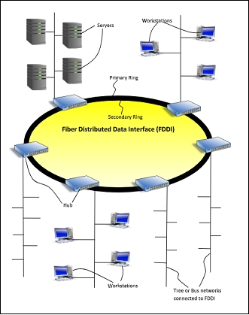
Fiber Distributed Data Interface
FDDI stands for Fiber Distributed Data Interface. It is a collection of ANSI and ISO standards for data transmission on fiber-optic lines in a local area network (LAN) that can broaden in the range up to 200 km (124 miles). The FDDI protocol depends on the token ring protocol.
FDDI cabling consists of two fiber rings, one transmitting clockwise and the other transmitting counterclockwise. Fiber Distributed Data Interface (FDDI) is generally implemented as a dual token-passing ring within a ring topology (for campus networks) or star topology (inside a building). The dual ring includes a primary and secondary ring.
The primary ring transport data. The counter-rotating secondary ring can hold data in the opposite direction but is more frequently reserved as an alternative in case the primary ring goes below. This supports FDDI with the cost of fault tolerance essential for network backbones.
FDDI allows nodes to connect to the network by means of a single cable, such nodes are called single attainment (SAS), and their dual-connected counterpart is called dual attachment station (DAS).

Slide 79
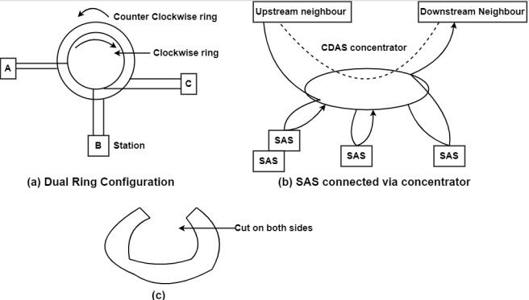

Slide 80
There are two types of traffic in FDDI, which are as follows−
Synchronous FDDI: It means that the traffic is delay sensitive, used to send voice or video. Whenever a node receives a token, it is allowed to send synchronous data without regard to whether the token is early or late.
Asynchronous FDDI: It is used only when the token is early.
In the FDDI mechanism, Token is always in circulation & different from 802.5. All rings on FDDI monitor that token is not lost. FDDI MAC protocol uses three timers as the first one is holding a timer to determine how long a station may-continue to transmit once it has acquired a token.
The second rotation timer is restarted every time the token is seen. If the timer expires, it means that the one has not been sighted for two Rings on interval or has been lost. The third timer is the transmission timer used to time out and recover from certain transient ring errors.

Slide 81
Features
FDDI uses optical fiber as its physical medium.
It operates in the physical and medium access control (MAC layer) of the Open Systems Interconnection (OSI) network model.
It provides high data rate of 100 Mbps and can support thousands of users.
It is used in LANs up to 200 kilometers for long distance voice and multimedia communication.
It uses ring based token passing mechanism and is derived from IEEE 802.4 token bus standard.
It contains two token rings, a primary ring for data and token transmission and a secondary ring that provides backup if the primary ring fails.
FDDI technology can also be used as a backbone for a wide area network (WAN).

Slide 82
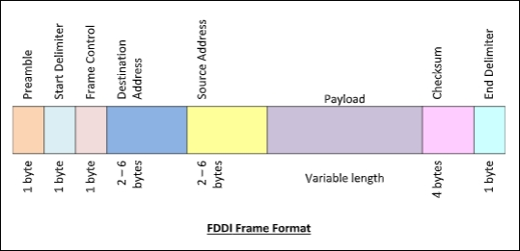
Frame Format
The fields of an FDDI frame are −
Preamble: 1 byte for synchronization.
Start Delimiter: 1 byte that marks the beginning of the frame.
Frame Control: 1 byte that specifies whether this is a data frame or control frame.
Destination Address: 2-6 bytes that specifies address of destination station.
Source Address: 2-6 bytes that specifies address of source station.
Payload: A variable length field that carries the data from the network layer.
Checksum: 4 bytes frame check sequence for error detection.
End Delimiter: 1 byte that marks the end of the frame.

Slide 83
Advantages of FDDI
Fibre optic cables that enable the transmission of signals across the noteworthy distance of about nearly 200 km.
Request is raised at the work stations linked to the chain for the requirements
According to the prerequisite usage, some stations are avoided in order to deliver quick benefit for the rest
FDDI employs several tokens to meet the speed requirements
Transmission capacity is high at up to 250 Gbps
It can manage data rates of up to 100 Mbps
FDDI provides complete security as it becomes more troubling to spy on the fibre-optic link
The cable is fibre-optic and will not break as easily as the other cables
Disadvantages of FDDI
Because of its complexity, the setting up and support calls for an extensive bargaining of the skills
Since the fibre optic cable, connectors and the concentrators are very expensive, the FDDI will also cost a lot

Slide 84
Ethernet(IEEE 802.3)
Ethernet describes a technology for cabled data networks that connect software and/or hardware with each other. This mostly takes place via LAN cables, which is why Ethernet is also sometimes referred to as LAN technology. In this way, Ethernet enables data exchanges between end devices. These could be computers, printers, servers, routers, or others. When combined into a local network, these devices establish connections via the Ethernet protocol and can exchange data packages with one another. The current and most widely distributed protocol is IEEE 802.3.
Ethernet was developed back in the early 1970s, but the network system was originally only used internally by the company Xerox. At the start of the 1980s, Ethernet was developed into a standardized product. However, Ethernet still wasn’t widely used until the middle of the decade when several manufacturing companies started to work with Ethernet and related products. The technology made a significant contribution to the way that the personal computer revolutionized the working world. Today, the widely-distributed IEEE standard 802.3 is used in offices, private households, containers, and carriers.
While the first version of the technology only had a speed of 3 megabits per second, Ethernet protocol today enables speeds of up to 1.000 megabits per second. Earlier Ethernets were limited to a building, but today Ethernet can cover a range of just over 6 miles with the use of fiber optic cables. Over the course of its development, Ethernet has taken over a dominant role among LAN technology and outperformed various competitors. In addition, today real-time Ethernet is the industry standard for communication applications.

Slide 85
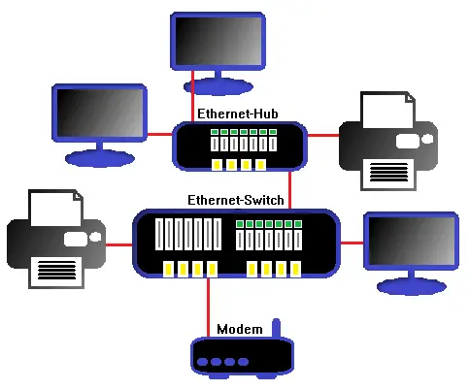
How does Ethernet work?
Every device in an Ethernet network receives its own 48-bit address, called the MAC address. Participants in the same network can exchange high-frequency messages.
For this, Ethernet uses baseband and multiplexing. The smooth CSMA/CD (carrier sense multiple access/collision detection) algorithm is used for communication with one another. The network topology of Ethernet is logical, so the structure can be implemented as a bus or star, for example.
Communication with this algorithm is similar to a round table discussion, where each participant lets the other speak out. If two messages collide, then the participants try to send them out again at random intervals. Because a communication has to be sent as well as received to be successful, there can’t be any data jams – for example, if a sent message is too strong for a relatively weak reception performance. Otherwise, data may be lost. Signal speed and transfer rates control the smooth communication by defining rules for the data frames.
To prevent a data collision, a corresponding signal has to reach the receiver before the data package. Because most networks these days function in full-duplex mode, though, this is rarely a problem. But it was quite important for the earlier development of the Ethernet technology.

Slide 86
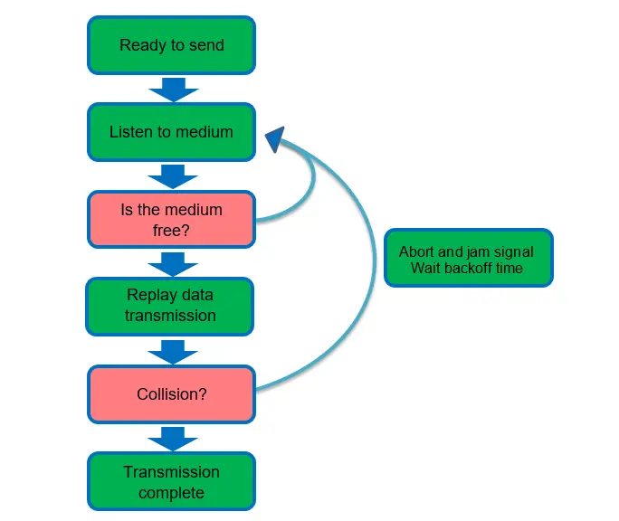
Originally, each message that was sent within a network went to all connected devices. These then had to filter through all received data and decide whether it was relevant to them. This common bus enabled broadcast messages, but also recorded all data traffic for each member – clearly a security gap of early Ethernet. Data could be encrypted, but data traffic itself couldn’t be individually controlled. Hubs also couldn’t close this security gap. Bridges and switches are a solution in modern networks, as they can be used to segment the Ethernet.
This technology doesn’t solve all problems, though. Abuse by MAC flooding or MAC spoofing, for example, still poses a danger for the stability of the network and the security of the communicated data packages. Working securely with Ethernet therefore requires serious use of all connected systems and regular data analysis (e.g. LAN analysis) to uncover potential cases of misuse or disturbances.
As long as an Ethernet’s data amount isn’t at capacity, it functions well. Capacity utilization rates of more than 50 percent can cause data jams, though. As personal computers developed technologically and continuously increased their data volume, Ethernet networks also had to develop further to keep pace with the progress of technology. Switches are responsible for efficiently dividing data packages and minimizing the risk of collisions. Modern cable technologies like twisted pair and fiber optic have higher transfer rates meet the modern requirements for a network.
Another innovation is ‘Ethernet flow control’. With this mechanism, data transfer can temporarily be stopped to alleviate data flow from another location. This is especially practical in full-duplex mode when a network serves a relatively high number of end devices. The flow control for specific members of the network is temporarily cut off to optimize the overall reliability of the network. This can also cause losses in speed, though, which can then be stemmed by other mechanisms such as the transmission control protocol.
In the past, Ethernet primarily used conventional coaxial cables. Today, twisted pair copper cables and fiber optical cables are the industry standard, as they enable much faster transfer rates and a larger range. Another advantage is that copper cables can also supply power to connected devices. This method, called ‘power over Ethernet’ (PoE), is specified in IEEE 802.3af and enables energy-efficient networks.

Slide 87
Ethernet Evolution (IEEE 802.3)
1. Original Ethernet (1970s–1980s)
10BASE5 (Thick Ethernet)
Standard: IEEE 802.3
Speed: 10 Mbps
Medium: Thick coaxial cable
Topology: Bus
Access method: CSMA/CD
Max length: 500 m
How it worked
All devices shared one cable
If two devices transmitted at once → collision
Collision detected → devices back off randomly → retry
Reality check
Worked fine with few devices
Performance collapsed as nodes increased
Troubleshooting was a nightmare (one bad tap = network down)
👉 This design cannot scale. Period.
Ethernet did not evolve just to increase speed. It evolved to solve four hard problems:
Collisions
Scalability
Distance
Bandwidth demand
Every generation fixes at least one of these.

Slide 88
2. Thin Ethernet (10BASE2)
Why it existed
To make Ethernet:: Cheaper, Easier to install
Characteristics
Speed: 10 Mbps, Medium: Thin coax
Topology: Bus, Max length: 185 m
Improvement?
Only in cost and flexibility.
Core problems remained
Shared medium, Collisions
Single collision domain
👉 Still fundamentally broken at scale.
3. Twisted Pair Ethernet (10BASE-T) — First Major Shift
What changed
Medium: Twisted pair (UTP)
Topology: Star
Device: Hub (not switch)
Why this mattered
Physical layout improved
Easier expansion
Fault isolation improved
What did NOT change
Still shared bandwidth
Still CSMA/CD
Hub = multi-port repeater
👉 Logically, it was still a bus network, just wired as a star.

Slide 89
4. Fast Ethernet (100 Mbps) — Bandwidth Pressure
Standard
IEEE 802.3u
100BASE-TX (most common)
Improvements
10× speed increase
Better encoding (4B/5B)
Better cable quality (Cat 5)
Key misconception
People think Fast Ethernet fixed collisions.
❌ Wrong.
With hubs: CSMA/CD still used
With switches: collisions eliminated
👉 Speed alone did not solve Ethernet’s core problems.
5. Bridged Ethernet — First Real Intelligence
What bridges introduced
MAC address learning
Frame filtering
Multiple collision domains
Result
Traffic only forwarded where needed
Reduced unnecessary frame propagation
Limitations
Still software-based
Few ports
Broadcast traffic still everywhere
👉 Bridges proved Layer 2 intelligence works, but performance was limited.

Slide 90
7. Gigabit Ethernet (1 Gbps)
Standards
802.3z → Fiber
802.3ab → Copper (1000BASE-T)
Key technical changes
PAM-5 encoding (copper)
All four wire pairs used
Heavy DSP usage
Important detail
Half-duplex technically defined
Practically never used
👉 Gigabit Ethernet assumes switching.
6. Switched Ethernet — The Real Revolution
This is where classic Ethernet effectively died.
What switches changed fundamentally
Each port = separate collision domain
Full-duplex communication
No collisions
CSMA/CD becomes irrelevant
Technical consequences
Ethernet stops being contention-based
Becomes point-to-point
Deterministic performance
💡 Modern Ethernet is not CSMA/CD-based. That’s legacy theory.
8. 10 Gigabit Ethernet — Death of CSMA/CD
Standard
IEEE 802.3ae
What disappeared
Half-duplex ❌
CSMA/CD ❌
Hubs ❌
Why?
Timing constraints make collision detection impossible at 10 Gbps
Ethernet officially becomes full-duplex only
This is the formal end of classic Ethernet.
9. High-Speed Ethernet (40G, 100G, 400G)
Standards
802.3ba → 40G / 100G
802.3bs → 200G / 400G
Focus shifts to
Parallel lanes
Fiber optics
Data centers
Low latency
Ethernet now competes with
InfiniBand
Fibre Channel
👉 Ethernet is no longer “just LAN tech”. It’s data-center infrastructure.

Slide 91
Bridged Ethernet
Bridged Ethernet is a networking technique that connects two or more separate network segments at the Data Link Layer (Layer 2) of the OSI model, making them function as a single, unified logical network.
How It Works
A bridge maintains a MAC address forwarding table to manage traffic flow:
Learning: When a frame arrives, the bridge records the source MAC address and the port it came from.
Filtering: If the destination MAC address is on the same segment as the sender, the bridge drops the frame to keep local traffic from clogging other segments.
Forwarding: If the destination is on a different segment, the bridge sends the frame only to that specific port.
Flooding: If the destination address is unknown, the bridge broadcasts the frame to all ports except the incoming one.
Core Benefits
Network Segmentation: It divides a large network into smaller collision domains, which reduces traffic congestion and increases available bandwidth per segment.
Extension: It allows you to connect different physical media, such as bridging a wired Ethernet network with a Wi-Fi network.
Transparency: Connected devices are unaware of the bridge; they communicate as if they are on the same local segment.

Slide 92
Implementation and Protocols
Spanning Tree Protocol (STP): Used to prevent "bridge loops" where frames circulate indefinitely, which can cause network crashes known as broadcast storms.
Software Bridging: Most modern operating systems support virtual bridging. For example, in Windows 10/11, you can select two network adapters in the Control Panel, right-click, and choose "Bridge Connections".
Bridge vs. Switch: A modern network switch is essentially a multiport bridge that provides a dedicated segment for every connected node.
Common Use Cases
Virtualization: Bridging a physical network card to a virtual machine (VM) so the VM appears as a real device on the local network.
Extending Connectivity: Connecting a device that only has an Ethernet port (like an older game console) to a wireless network by using a PC or dedicated wireless bridge.
WLAN Integration: Allowing wireless clients and wired workstations to share files and printers seamlessly.

Slide 93
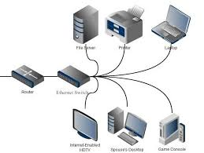
Switched Ethernet
An Ethernet switch sets up networks and communicates throughout LAN devices using several ports. Ethernet switches differ from routers, which connect networks with only one LAN and WAN port. A fully wired and wireless corporate infrastructure includes wired connectivity as well as wireless communication by Wi-Fi.
Ethernet switching links devices that are connected, including computers, laptops, routers, servers, and printers, to a local area network (LAN). Multiple Ethernet switch ports provide more quickly connectivity and simpler connectivity for multiple devices at once. Hubs, which are like
Ethernet switches, have many ports by which connected devices on the LAN can be wired. The primary difference is that hubs distribute bandwidth properly throughout ports, whereas Ethernet switches may provide extra bandwidth to particular ports without decreasing network performance. When there are several devices on a network, Ethernet switching provides better performance.
Routers create connections between networks; they commonly link local area networks (LANs) to wide area networks (WANs). Routers are frequently situated at the network's gateway to send data packets along the network.
Combinations of switches, routers, hubs, and wired and wireless technologies are used in the majority of business networks.

Slide 94
How Do Switched Ethernet Work?
Ethernet switches connect many devices by physically connecting them to the same switch or to another switch on the same network. These cables include coaxial, fiber optic, and twisted-pair Ethernet cables.
When a device connects to a port, the Ethernet switch controls the flow of data between it and other devices, applications, data, cloud services, and the internet. The switching mechanism routes incoming and outgoing data to the correct switch port based on the sending device's port as well as the sending and destination MAC addresses. The MAC addresses of the sender and destination are provided, and the data is sent in an Ethernet frame.
Every Ethernet-compatible device has a set up physical identifier known as a MAC address, which the connected switch uses to uniquely identify each device.
When a switch receives an Ethernet packet, it records the sender device's MAC address and the port to which it is attached in a locally stored database known as a MAC address table. The switch process then checks the MAC address table to verify if the destination MAC address is already linked to the same switch. If it is, the switch routes the packet to the known target port. If not, the switch sends out the packet to all ports and waits for a response.
If the switch has a connection to the destination device, the device receives the data packet, responses, and the transmission is complete. If the device is linked to another switch, the following switch will repeat the search and forward operation until the frame arrives at its destination.
Ethernet switches range in size and capability from tiny devices like those in a house, to very fast, terabit-speed core switches. Ethernet switches are classified into three varieties based on their network structure or size: access, distribution, and core. Switching networks frequently feature a tree-root structure, with smaller switches connecting to devices at the access edge, bigger switches functioning as distribution, and finally larger switches working as core switches.

Slide 95
Applications of Switched Ethernet
Ethernet switches are used for the following purposes.
These switches play a role in connecting wired devices such as laptops, PCs, servers, printers, and routers to the local area network.
This switch is a type of network equipment that serves as the foundation for both the internet and networking.
There are various Ethernet switch ports which allow easier and faster communication between multiple devices.
This switch connects many ports and forms a network for communication with other devices on the Local Area Network.
This is the most popular form of network switch used in Ethernet for connecting multiple Ethernet devices using packet switching to process, forward, and receive data from one device to another.
This switch simply converts one Ethernet cable into many wired connections.
This is a physical device that is commonly used in workplace networks or buildings.

Slide 96
WLAN(WiFi) and IEEE 802.11
1. What is WLAN (Wi-Fi)?
WLAN = Wireless Local Area Network
It is a local network that uses radio waves instead of cables
Covers short range (home, office, campus, café)
Wi-Fi is NOT the internet → Wi-Fi is just the wireless link to a network → Internet access is optional
Reality check: People say “Wi-Fi is slow” — wrong. Bad routers, interference, distance, or congestion are slow. The technology itself is fast.
2. What is IEEE 802.11?
IEEE 802.11 is the STANDARD behind Wi-Fi
IEEE = Institute of Electrical and Electronics Engineers
802.11 defines:
Frequencies
Data rates
Modulation
Security
MAC layer rules
👉 All Wi-Fi devices MUST follow 802.11 standards
No 802.11 → no Wi-Fi.

Slide 97
WLAN
WLAN stands for Wireless Local Area Network. WLAN is a local area network that uses radio communication to provide mobility to the network users while maintaining the connectivity to the wired network. A WLAN basically, extends a wired local area network.
WLAN's are built by attaching a device called the access point(AP) to the edge of the wired network. Clients communicate with the AP using a wireless network adapter which is similar in function to an ethernet adapter. It is also called a LAWN is a Local area wireless network. The performance of WLAN is high compared to other wireless networks. The coverage of WLAN is within a campus or building or that tech park. It is used in the mobile propagation of wired networks. The standards of WLAN are HiperLAN, Wi-Fi, and IEEE 802.11. It offers service to the desktop laptop, mobile application, and all the devices that work on the Internet.
WLAN is an affordable method and can be set up in 24 hours. WLAN gives users the mobility to move around within a local coverage area and still be connected to the network. Most latest brands are based on IEE 802.11 standards, which are the WI-FI brand name.

Slide 98
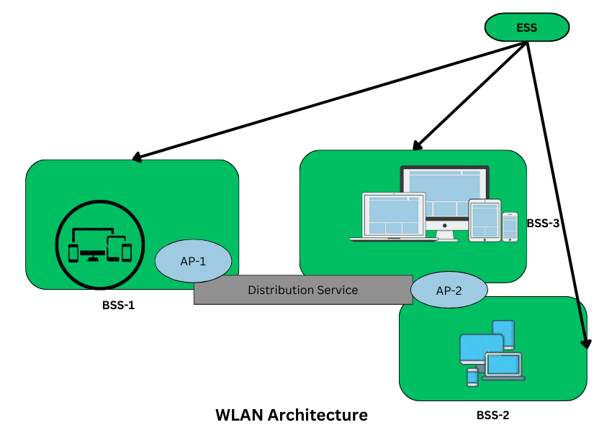
WLAN Architecture
Components in Wireless LAN architecture as per IEEE standards are as follows:
Stations: Stations consist of all the equipment that is used to connect all wireless LANs. Each station has a wireless network controller.
Base Service Set(BSS): It is a group of stations communicating at the physical layer.
Extended Service Set(ESS): It is a group of connected Base Service Set(BSS).
Distribution Service (DS): It connects all Extended Service Set(ESS).

Slide 99
Types of WLANs
As per IEEE standard WLAN is categorized into two basic modes, which are as follows:
Infrastructure: In Infrastructure mode, all the endpoints are connected to a base station and communicate through that; and this can also enable internet access. A WLAN infrastructure can be set up with: a wireless router (base station) and an endpoint (computer, mobile phone, etc). An office or home WiFi connection is an example of Infrastructure mode.
Ad Hoc: In Ad Hoc mode WLAN connects devices without a base station, like a computer workstation. An Ad Hoc WLAN is easy to set up it provides peer-to-peer communication. It requires two or more endpoints with built-in radio transmission.
Working of WLAN
WLAN transmits data over radio signals and the data is sent in the form of a packet. Each packet consists of layers, labels, and instructions with unique MAC addresses assigned to endpoints. This enables routing data packets to correct locations.
How is a WLAN Created ?
A WLAN is a collection of nodes interconnected with each other for the purpose of data sharing, transmitting messages over the internet, connecting for peer-2-peer connectiob etc. As discussed above in types, it can be created in following 2 ways :
Connecting through one base station and that could be the router that acts as a doorway to the internet, and every other nodes (devices like computer, smartphones) can connect to the internet and to each other through it.
Peer-2-Peer connection using the wifi direct technology. This is more suitable for situations when we require to connect two or more devices without internet and only for purpose of data exchange, connecting over a same local network.

Slide 100
IEEE 802.11
The IEEE 802.11 standard, commonly known as Wi-Fi, outlines the architecture and defines the MAC and physical layer specifications for wireless LANs (WLANs). Wi-Fi uses high-frequency radio waves instead of cables for connecting the devices in LAN.
Given the mobility of WLAN nodes, they can move unrestricted within the network coverage zone. The 802.11 structure is designed to accommodate mobile stations that participate actively in network decisions. Furthermore, it can seamlessly integrate with 2G, 3G, and 4G networks.
The Wi-Fi standard represents a set of wireless LAN standards developed by the Working Group of IEEE LAN/MAN standards committee (IEEE 802).
The term 802.11x is also used to denote the set of standards. Various specifications and amendments include 802.11a, 802.11b, 802.11e, 802.11g, 802.11n etc.

Slide 101
Important Terminologies of IEEE 802.11 Architecture
Station: Stations (STA) comprise all devices and equipment that are connected to the wireless LAN. It can be of two types:
Wireless Access Point (WAP): WAPs or simply access points (AP) are wireless routers that bridge connections for base stations.
Client: Examples include computers, laptops, printers, and smartphones.
Access Point: It is a device that can be classified as a station because of its functionalities and acts as a connection between wireless medium and distributed systems.
Distribution System: A system used to interconnect a set of BSSs and integrated LANs to create an ESS.
Frame: It is a MAC protocol data unit.
SSID (Service Set Identifier): It’s the network name for a particular WLAN. All-access points and devices on a specific WLAN must use the same SSID to communicate.
SDU: It is a data unit that acts as an input to each layer. These can be fragmented or aggregated to form a PDU.
PDU: It is a data unit projected as an output to communicate with the corresponding layer at the other end. They contain a header specific to the layer.
Network Interface Controller: It is also known as network interface card. It is a hardware component that connects devices to the network.
Portal: Serves as a gateway to other networks

Slide 102
IEEE 802.11 Architecture and Services
In the year 1990, IEEE 802.11 Committee formed a new working group, the IEEE 802.11 standard which defines protocols for Wireless Local Area Networks (WLANs). Just like how Ethernet provides services for wired media, IEEE 802.11 architecture is designed to provide features for wireless networks.
An AP supports both wired and wireless connections. The 802.11 standard calls the upstream wired network the distribution system (DS). The AP bridges the wireless and wired L2 Ethernet frames, allowing traffic to flow from the wired to the wireless network and vice versa. Each wireless network has a unique SSID.
The 802.11 architecture provides some basic services for WLANs whose implementation is supported by MAC layer:
Basic Service Set
The Basic Service Set configuration consists of a group of stations and relies on an Access Point (AP), which serves as a logical hub. Stations from different BSSs interact through the AP, which functions as a bridge, linking multiple WLAN cells or channels.

Slide 103
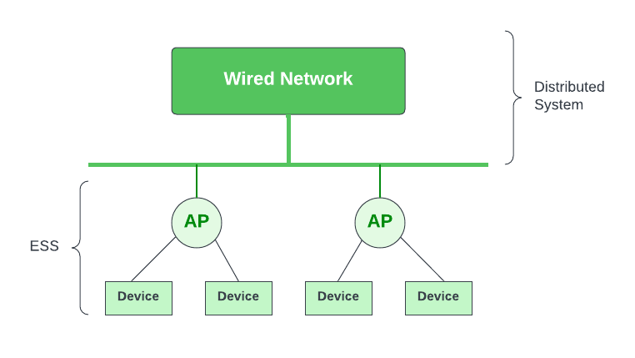
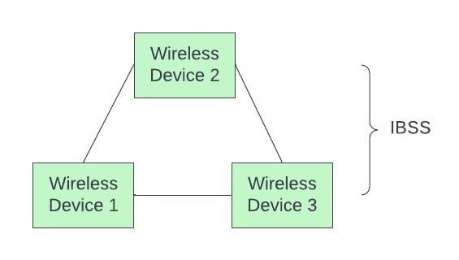
Operating Modes
Depending upon the mode of operation, BSS can be categorized into the following types:
Infrastructure BSS: Communication between stations takes place through access points. The AP and its associated wireless clients define the coverage area and form the BSS.
Independent BSS - Supports mutual communication between wireless clients. An ad-hoc network is spontaneously created and does not support access to wired networks.

Slide 104
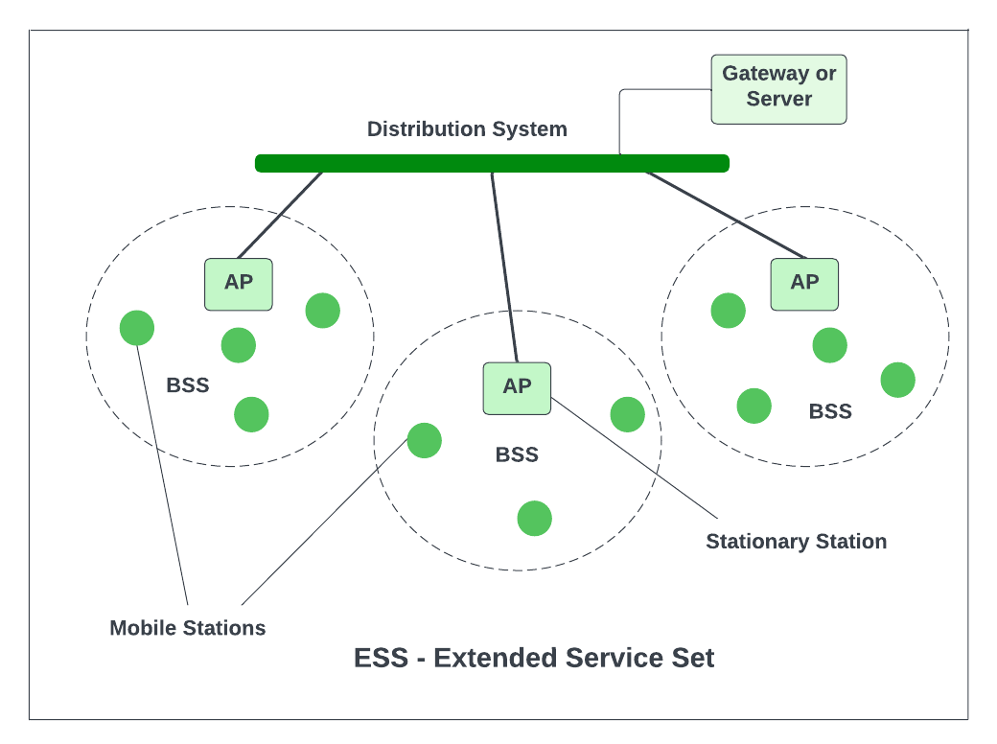
Independent Basic Service Set
In the IBSS configuration, also referred to as independent configuration or ad-hoc network, no single node is required to act as a server. The stations communicate directly with one another in a peer-to-peer basis. Generally, IBSS covers a limited area instead of a large network. Typically covering a specific area, IBSS is used for specific, short-term purposes with a limited number of nodes.
Extended Service Set
ESS connects multiple BSSs and consists of several BSS cells, which can be interlinked through wired or wireless backbones known as a distributed system. Multiple cells use the same channel to boost aggregate throughput to network. The equipment outside of the ESS, the ESS and all of its mobile stations comprise a single MAC layer network where all stations are virtually stationary. Thus, all stations within the ESS appear stationary from an outsider's perspective.
Other components include:
Distribution System (DS): Links APs within the ESS.
Portal: Serves as a gateway to other networks.
Roaming: In an environment with multiple access points (like a large office building or campus), a device can move from the range of one AP to another and still maintain its connection. This is possible due to the underlying architecture of the IEEE 802.11 standard which allows for roaming between APs.
Authentication and Association: Before a station can send or receive data frames on a WLAN, it needs to establish its identity with an AP. This process is called authentication. After authentication, the station then establishes a data link-layer connection with the AP through a process called association.

Slide 105
Frame Format of IEEE 802.11
Frame Control
It is 2 bytes long and defines type of frame and control information. The types of fields present in FC are:
Version: Indicates the current protocol version.
Type: Determines the function of frame i.e. management(00), control(01) or data(10).
Subtype: Indicates subtype of frame like 0000 for association request, 1000 for beacon.
To DS: When set indicates that the destination frame is for DS(distribution system).
From DS: When set indicates frame coming from DS.
More frag (More fragments): When set to 1 means frame is followed by other fragments.
Retry: If the current frame is a re-transmission of an earlier frame, this bit is set to 1.
Power Mgmt (Power Management): It indicates the mode of a station after successful transmission of a frame. Set to '1' field indicates that the station goes into power-save mode. If the field is set to 0, the station stays active.
More data: It is used to indicate to the receiver that a sender has more data to send than the current frame.
WEP: It indicates that the standard security mechanism of 802.11 is applied.
Order: If this bit is set to 1 the received frames must be processed in strict order.
Duration / ID
It contains the value indicating the period of time in which the medium is occupied (in µs).
Address 1 to 4
These fields contain standard IEEE 802 MAC addresses (48 bit each). The meaning of each address is defined by DS bits in the frame control field.
SC (Sequence Control)
It consists of 2 sub-fields i.e. sequence number (12 bits) and fragment number (4 bits). Sequence number is used to filter duplicate frames.
Data
It is a variable length field which contains information specific to individual frames which is transferred transparently from a sender to the receiver.
CRC (Cyclic Redundancy Check)
It contains 32 bit CRC error detection sequence to ensure error free frame.

Slide 106
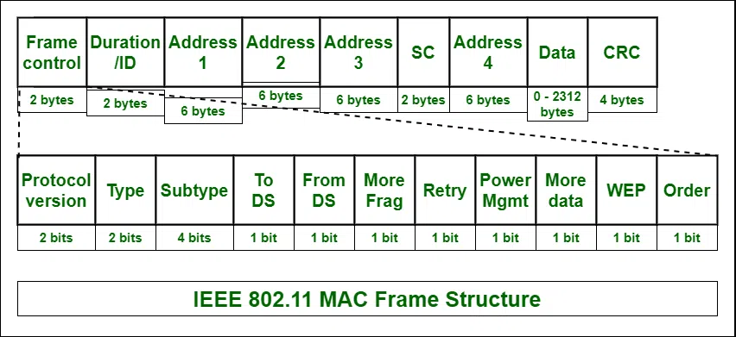

Slide 107
Advantages and Disadvantages of IEEE 802.11 Architecture
There are some list of Advantages and Disadvantages of IEEE 802.11 Architecture are given below :
Advantages of IEEE 802.11 Architecture
Fault Tolerance: The centralized architecture minimizes the bottlenecks and introduces resilience in the WLAN equipment.
Flexible Architecture: Supports both temporary smaller networks and larger, more permanent ones.
Prolonged Battery Life: Efficient power-saving protocols extend mobile device battery life without compromising network connections.
Disadvantages of IEEE 802.11 Architecture
Noisy Channels: Due to reliance on radio waves, signals may experience interference from nearby devices.
Greater Bandwidth and Complexity: Due to necessary data encryption and susceptibility to errors, WLANs need more bandwidth than their wired counterparts.
Speed: Generally, WLANs offer slower speeds compared to wired LANs.

Slide 108
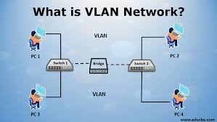
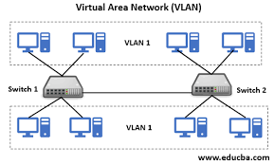
Virtual Local Area Network (VLAN)
A virtual local area network abbreviated VLAN is a logical subnetwork of devices situated in a broadcast domain. It is segregated by network management software or network switches to serve as a LAN.
Courtesy of VLAN switches, network managers can easily create virtual network segments.

Slide 109
Types of VLANs
Many organizations with complex network systems have adopted VLANs for solutions to scale networks, increase security measures, and get rid of network latency. In such scenarios, VLAN comes in handy by allowing devices and multiple LANs to communicate via wireless internet.
Here are the types of VLANs you may need to know:
1. Static (Port-based) VLAN
This type of virtual LAN has a switch port that can be assigned to a VLAN member manually. The ports are instructed to communicate to designated VLANS and a specific port is attached to a particular VLAN.
Since all the ports are configured using an identical VLAN number, all the devices that connect to this port fall under the same broadcast domain.
The only challenge with this network type is determining the ideal ports for each VLAN. To determine a VLAN membership, you have to look at the setup information rather than a simple inspection of the switch’s physical port.
2. Dynamic (Use-based) VLAN
Network admins or engineers use Dynamic VLANs to disintegrate a network into tiered sectors as per resource authorisation. Then, the users are segmented into these VLANs depending on the resources they have access to.
Unlike Static VLANs, dynamic VLANs do not need an administrator to configure each port one by one. It can be done with a central server known as a VLAN Member Policy Server or VMPS. This VMPS is required to deal with port configuration immediately of every switch associated with the VLAN network.

Slide 110
How Do VLANs Work
VLANs give network managers an easy time to create virtual domains that link devices that communicate frequently with each other. The action reduces congestion and CPU overhead while improving security to the number of devices that can access a particular VLAN.
Most networks are made to handle traffic moving from one VLAN to the next by passing the traffic off to routers. Each device in a VLAN setup is assigned a VLAN ID and linked to a VLAN group using management software.
It implies that devices can fall into any physical LANs connected to a switch but they are segmented into a VLAN group functioning like it was connected to a LAN. In case, a network administrator wants to move a device from one VLAN to the next, they will move it to a new VLAN or different port on a switch through the network management software.
Benefits of VLANs
1. Better network performance
VLANs can streamline network performance by segmenting network traffic into smaller logical networks. This way, it reduces the broadcast traffic which in turn improves the overall network performance.
2. Improved network security
By segregating your network traffic, VLANs erect virtual walls, barring unauthorized access to sensitive information or resources.
3. Flexibility
Network administrators can configure VLANs dynamically to adjust network configurations easily when needed.
4. Simplified network management
VLANs also streamline network management, allowing administrators to herd their digital flock with ease. Troubleshooting, configuration, and maintenance – all become a breeze, thanks to the power of these virtualized networks.
5. Scalability
The most impressive feat of VLANs is their ability to scale with your growing digital empire. By segmenting your network into smaller, more manageable clusters, they pave the way for seamless expansion, ensuring your network can rise to the challenge of ever-increasing complexity.
6. Cost saving
By leveraging a single physical network infrastructure to host multiple virtual networks, VLANs help maximize your investment, making the most of your digital resources.

Slide 111
ATM (Asynchronous Transfer Mode)
Why ATM Was Created
In the late 1980s and 1990s, networks faced a serious limitation:
Circuit switching (telephone networks) handled voice well but was inefficient for data
Packet switching (IP networks) handled data well but offered no delay or QoS guarantees
ATM was designed to combine the strengths of both.
ATM aimed to:
Carry voice, video, and data on the same infrastructure
Support real-time applications such as video conferencing and voice calls
Provide guaranteed bandwidth, low delay, and low jitter
Allow service providers to engineer traffic precisely
At that time, IP networks were best-effort only and unreliable for real-time traffic. ATM filled that gap.
ATM (Asynchronous Transfer Mode) is a high-speed, connection-oriented, virtual-circuit-based switching technology designed to transmit voice, video, and data over a single network using fixed-size cells of 53 bytes.
Before data transmission begins, ATM establishes a virtual circuit between the sender and receiver. Once established, all cells follow the same path, ensuring ordered delivery, predictable delay, and guaranteed Quality of Service (QoS).
Two things are non-negotiable in the definition:
Fixed-size cells (53 bytes)
Virtual circuits
Miss either → incomplete or wrong definition.

Slide 112
Key Characteristics of ATM
Connection-oriented: ATM establishes a connection before data transfer begins, unlike IP which sends packets independently.
Virtual-circuit-based: Data flows through logical paths called virtual circuits, not physical circuits.
Fixed cell size (53 bytes): 5 bytes header, 48 bytes payload
Quality of Service (QoS)
ATM can guarantee: Bandwidth, Delay, Jitter, Cell loss rate
High speed
Common speeds: 155 Mbps (OC-3), 622 Mbps (OC-12), Higher in backbone networks
Layer operation
ATM primarily operates at Layer 2, but has Layer-1 dependencies due to physical transmission standards.

Slide 113
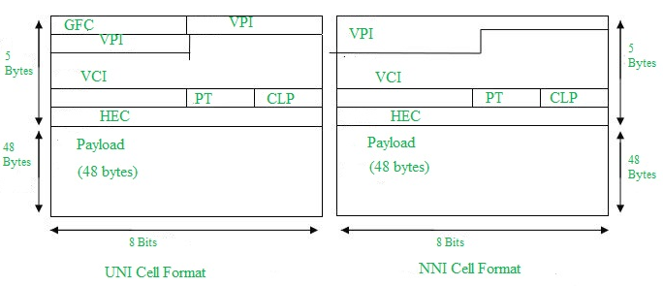
ATM Cell Structure
Header Fields (UNI – User Network Interface)
VPI (Virtual Path Identifier) Identifies a group of virtual channels
VCI (Virtual Channel Identifier) Identifies a specific virtual circuit
PTI (Payload Type Indicator) Indicates type of payload and congestion info
CLP (Cell Loss Priority) Marks cells that can be dropped during congestion
HEC (Header Error Control) Detects and corrects header errors
👉 VPI + VCI together uniquely identify a virtual circuit in the network.
UNI Header: This is used within private networks of ATMs for communication between ATM endpoints and ATM switches. It includes the Generic Flow Control (GFC) field.
NNI Header: is used for communication between ATM switches, and it does not include the Generic Flow Control(GFC) instead it includes a Virtual Path Identifier (VPI) which occupies the first 12 bits.
Field | Size
Header | 5 bytes
Payload | 48 bytes

Slide 114
Working of ATM:
ATM standard uses two types of connections. i.e., Virtual path connections (VPCs) which consist of Virtual channel connections (VCCs) bundled together which is a basic unit carrying a single stream of cells from user to user.
A virtual path can be created end-to-end across an ATM network, as it does not rout the cells to a particular virtual circuit. In case of major failure, all cells belonging to a particular virtual path are routed the same way through the ATM network, thus helping in faster recovery. Switches connected to subscribers use both VPIs and VCIs to switch the cells which are Virtual Path and Virtual Connection switches that can have different virtual channel connections between them, serving the purpose of creating a virtual trunk between the switches which can be handled as a single entity.
Its basic operation is straightforward by looking up the connection value in the local translation table determining the outgoing port of the connection and the new VPI/VCI value of connection on that link.

Slide 115
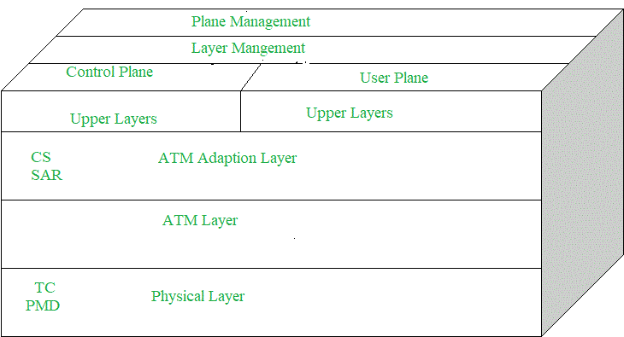
ATM Layers
ATM Adaption Layer (AAL) - It is meant for isolating higher-layer protocols from details of ATM processes and prepares for conversion of user data into cells and segments it into 48-byte cell payloads. AAL protocol excepts transmission from upper-layer services and helps them in mapping applications, e.g., voice, data to ATM cells.
Physical Layer - It manages the medium-dependent transmission and is divided into two parts physical medium-dependent sublayer and transmission convergence sublayer. The main functions are as follows:
It converts cells into a bitstream.
It controls the transmission and receipt of bits in the physical medium.
It can track the ATM cell boundaries.
Look for the packaging of cells into the appropriate type of frames.
ATM Layer - It handles transmission, switching, congestion control, cell header processing, sequential delivery, etc., and is responsible for simultaneously sharing the virtual circuits over the physical link known as cell multiplexing and passing cells through an ATM network known as cell relay making use of the VPI and VCI information in the cell header.

Slide 116
ATM Applications:
ATM WANs - It can be used as a WAN to send cells over long distances, a router serving as an end-point between ATM network and other networks, which has two stacks of the protocol.
Multimedia virtual private networks and managed services - It helps in managing ATM, LAN, voice, and video services and is capable of full-service virtual private networking, which includes integrated access to multimedia.
Frame relay backbone - Frame relay services are used as a networking infrastructure for a range of data services and enabling frame-relay ATM service to Internetworking services.
Residential broadband networks - ATM is by choice provides the networking infrastructure for the establishment of residential broadband services in the search of highly scalable solutions.
Carrier infrastructure for telephone and private line networks - To make more effective use of SONET/SDH fiber infrastructures by building the ATM infrastructure for carrying the telephonic and private-line traffic.

Slide 117

MPLS (Multiprotocol Label Switching)
MPLS, or Multiprotocol Label Switching, is a data forwarding technology that speeds up and manages network traffic flow. Unlike other protocols that route data based on network addresses, MPLS routes traffic using labelled paths for forwarding over private WANs.
MPLS networks offer security and flexibility, built over a private and resilient network that can be scaled to fit different site requirements.
MPLS provides better transmission and higher QoS than standard IP routing, making it ideal for businesses needing a reliable, powerful connection for latency-sensitive apps like VoIP and video conferencing. Its “multiprotocol” capability means that it can transfer various data types, independent of any specific protocol used to organize them, making it a versatile solution.

Slide 118


The name Multiprotocol Label Switching implies that it can encapsulate packets of various network protocols, such as IP, ATM, Frame Relay, SONET, and Ethernet. To gain a better understanding of MPLS, let’s take a look at how data moves through the internet.
Data sent over the internet is transmitted as an IP packet from a router to its intended destination. To reach its destination, each router performs an IP lookup (routing) to determine the next-hop. The next-hop is selected based on the router’s routing table. The router then forwards the packet to the next hop, and this process continues until the packet reaches its destination.
Using IP addresses and routing tables is effective for most of the Internet, but it can take longer to forward traffic. On the other hand, Multiprotocol Label Switching utilizes a “label switching” approach to handle the data flow. Label switching is when routers within a system create a planned route that controls network traffic, resulting in faster forwarding.
When the first device performs a routing lookup, it discovers the final destination router and a predetermined path from “here” to “that” router instead of a next-hop. Using this information, the router assigns a “label” to the traffic. Future routers then use the label to route the traffic rather than performing additional IP lookups. The packet will be delivered using standard IP routing, and the label will be removed at the final destination router.

Slide 119

Is MPLS Layer 2 or Layer 3 of the OSI model?
MPLS is referred to as a 2.5-layer protocol because of its location between Layer 2 (Data Link) and Layer 3 (Network) in the OSI model.
Sitting between Layer 2 & Layer 3, MPLS is considered a Layer 2.5 networking protocol.
While switching is a Layer 2 operation, routing is a Layer 3 operation. MPLS enables Internet routers to function like local network switches and can create end-to-end paths that behave like circuit-switched connections, but deliver Layer 3 IP packets. MPLS uses labels at Layer 2.5 to reduce the resource-intensive lookups at Layer 3 and helps in creating forwarding tables for any underlying protocol.

Slide 120

How does MPLS work?
MPLS works by adding a label to the data packet & route the packet from one node to the next based on the information written on the label.
Each packet in an MPLS network is assigned a class designation known as a forwarding equivalence class (FEC). Label-switched paths (LSPs) refer to the potential network routes that packets can take. The path (LSP) that a packet is assigned to is decided by its class (FEC). All packets with the same FEC always take the same LSP.
One or more labels are attached to each packet, and each label is in its own MPLS header, which is placed on top of all other headers. Each packet’s labels provide a list of FECs. Routers can disregard the IP header and other headers of the packet and instead look at the packet’s label to send it to the appropriate LSP.
An MPLS router located at the network edge adds an MPLS label whenever an end-user sends traffic into the MPLS network.
The MPLS label is consisted of four sections:

Slide 121

A MPLS header contains 32 Bits (4 Bytes) and is made of 4 sub sections: The Label Value, Experimental, Bottom-of-Stack, and Time-To-Live.
First 20 bits – The Label Value: The label contains all the information MPLS routers need to decide where to forward the packet.
Next 3 bits – Experimental: Experimental bits are used to determine the labeled packet’s priority and explicit congestion notification (ECN) under Quality of Service (QoS).
Next 1 bit – Bottom-of-Stack: Bottom-of-Stack notifies that the packet has reached the end of the MPLS network route, and there are no more labels to worry about. Typically, this indcates that the router is an egress router.
Last 8 bits – Time To Live (TTL): This indicates the maximum number of hops a packet can make before being discarded.

